Slide 1
1CroCEE 22-24.Mar.2021
The Institute of Structural Engineering, Earthquake Engineering and Construction IT - IKPIR
SEISMIC STRESS TEST OF THE BUILDING STOCK OF THE UNIVERSITY OF LJUBLJANA
Jure Starc

Slide 2
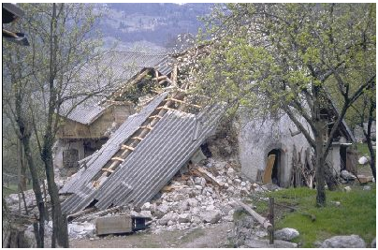
SEISMIC STRESS TEST & MOTIVATION
Seismic stress test – a tool for checking the seismic performance of a building stock based on seismic risk analysis (IKPIR, 2020; Dolšek et al., 2020).
No publicly available data regarding the UL building stock seismic resistance,
as the UL building stock represents the critical infrastructure, a seismic stress test was conducted (Starc, 2020; mentor M. Dolšek & co-supervisors A. Babič in J. Žižmond).
http://www.arso.si/potresi/potresna%20aktivnost/potres1998.html
22.03.2021
2

Slide 3
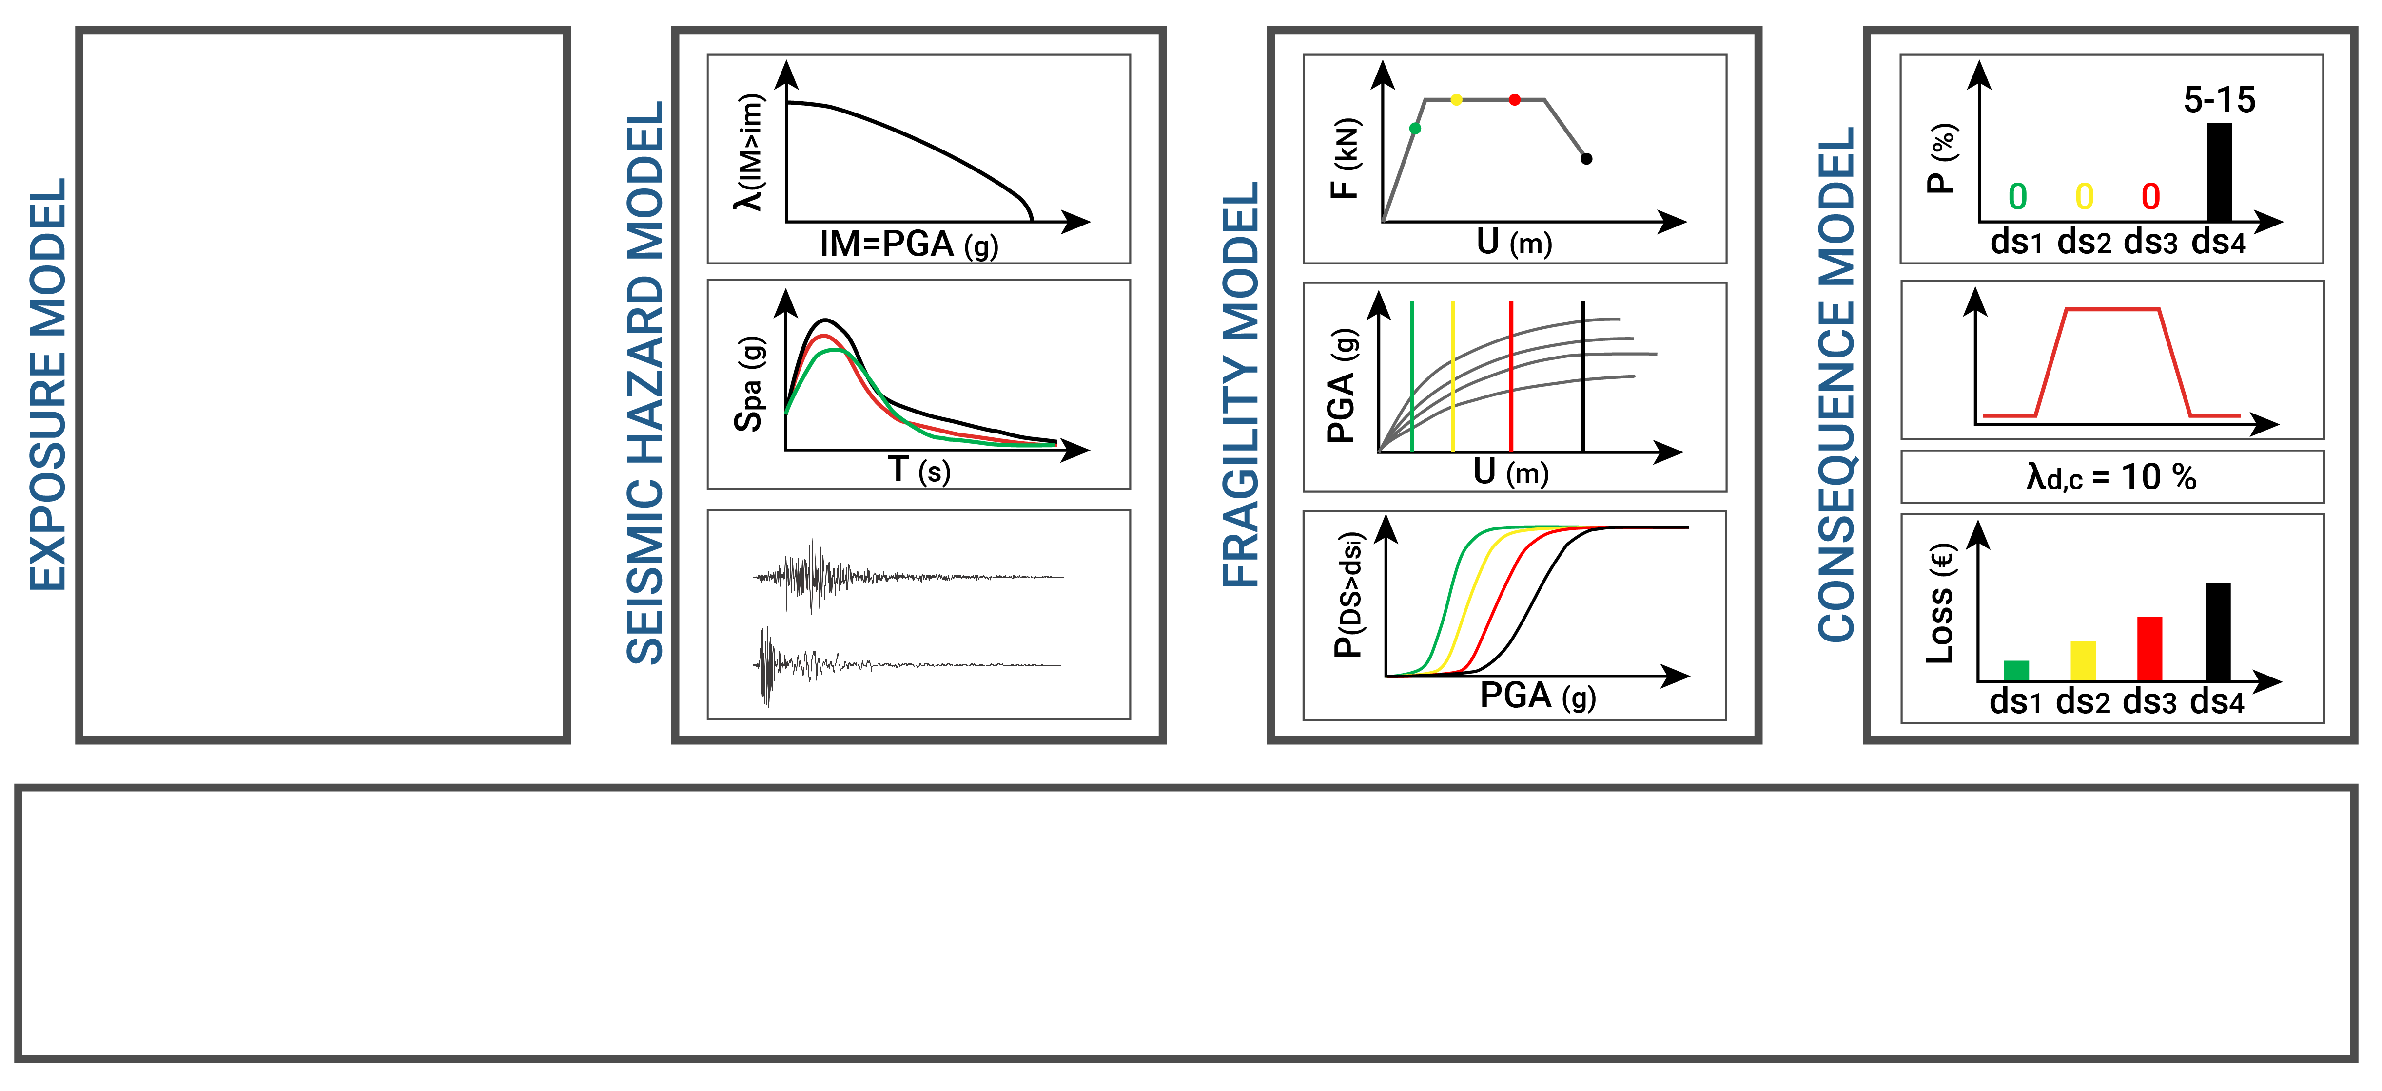
MODELS OF THE SEISMIC STRESS TEST
Building Knowledge Levels
1. Level of Knowledge
2. Level of Knowledge
3. Level of Knowledge
On average per observed period
Critical event
Existing building stock
Updated building stock
Risk indicators
num. of fatalities
economic losses
Applying all models
22.03.2021
3

Slide 4
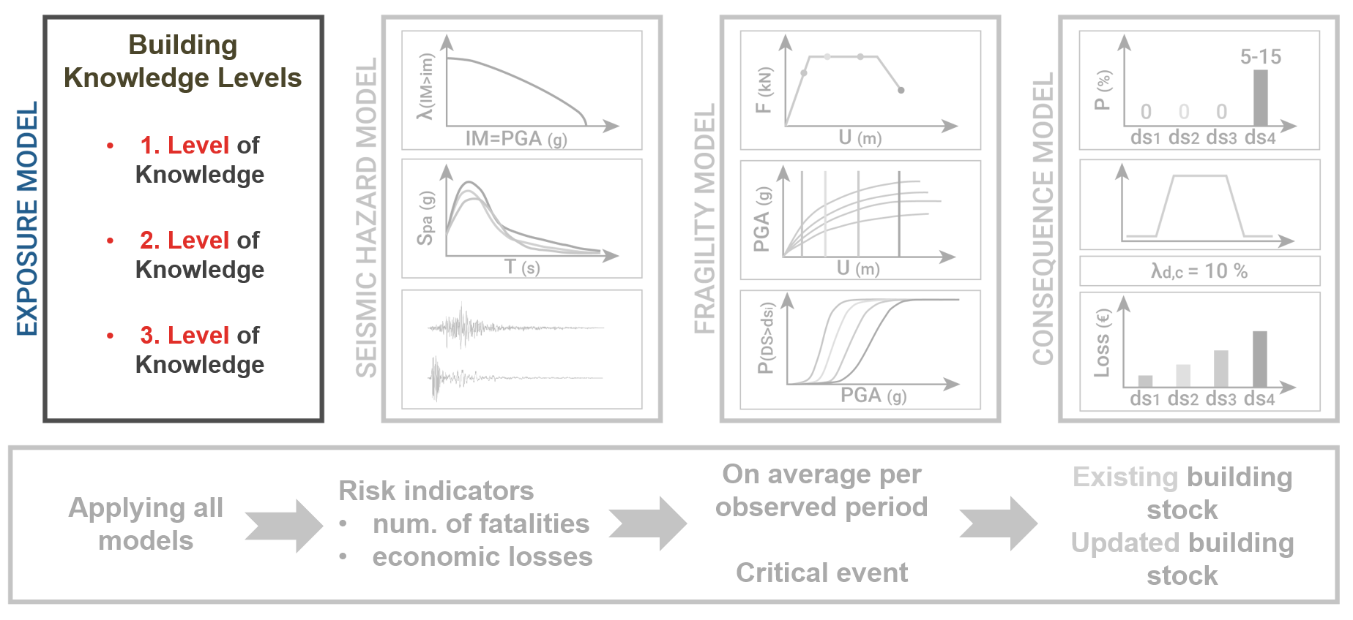
MODELS OF THE SEISMIC STRESS TEST
22.03.2021
3

Slide 5
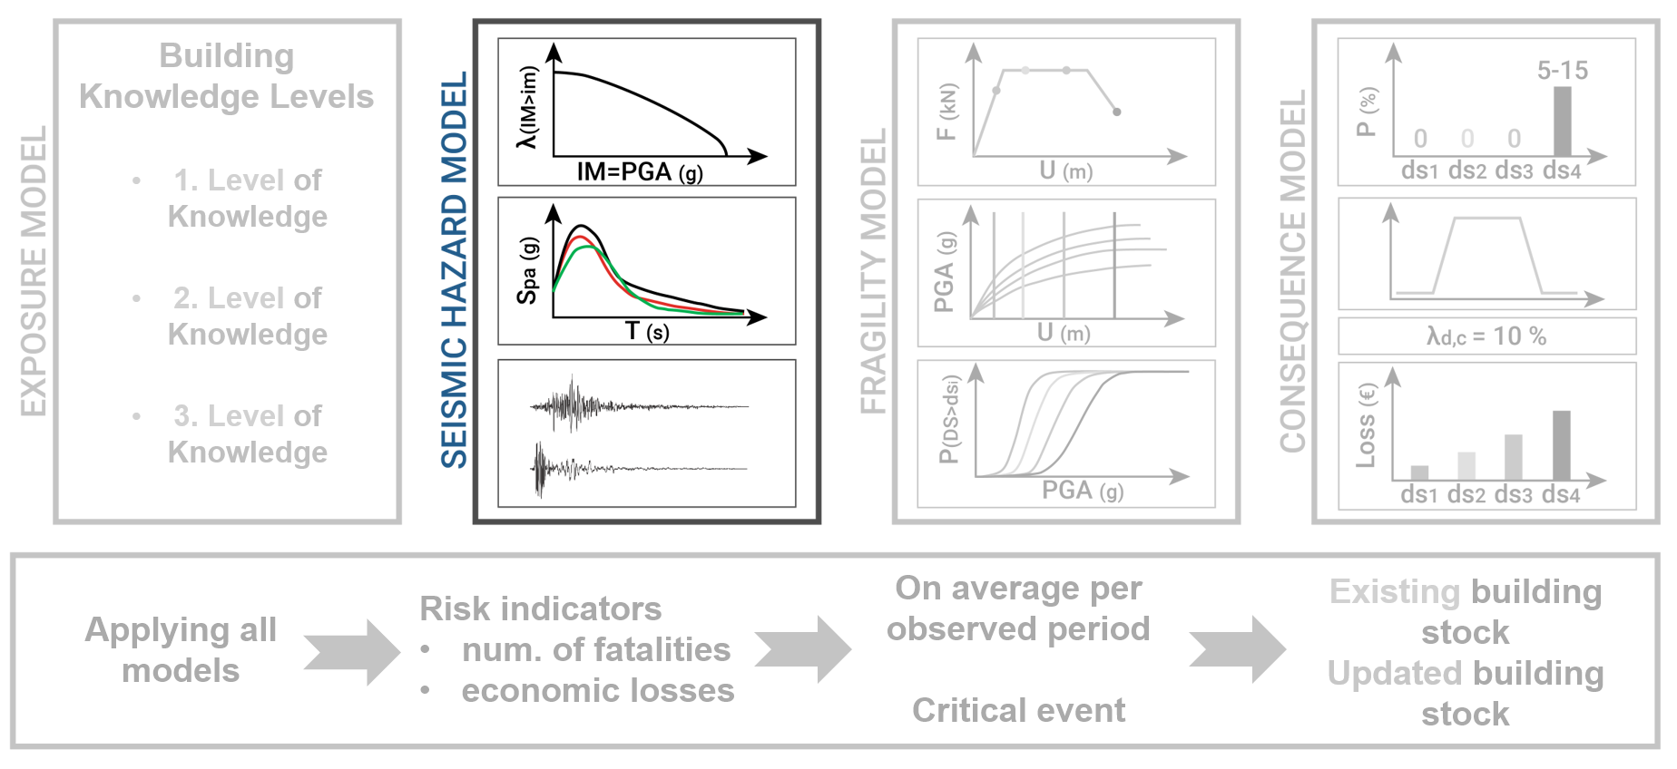
MODELS OF THE SEISMIC STRESS TEST
22.03.2021
3

Slide 6
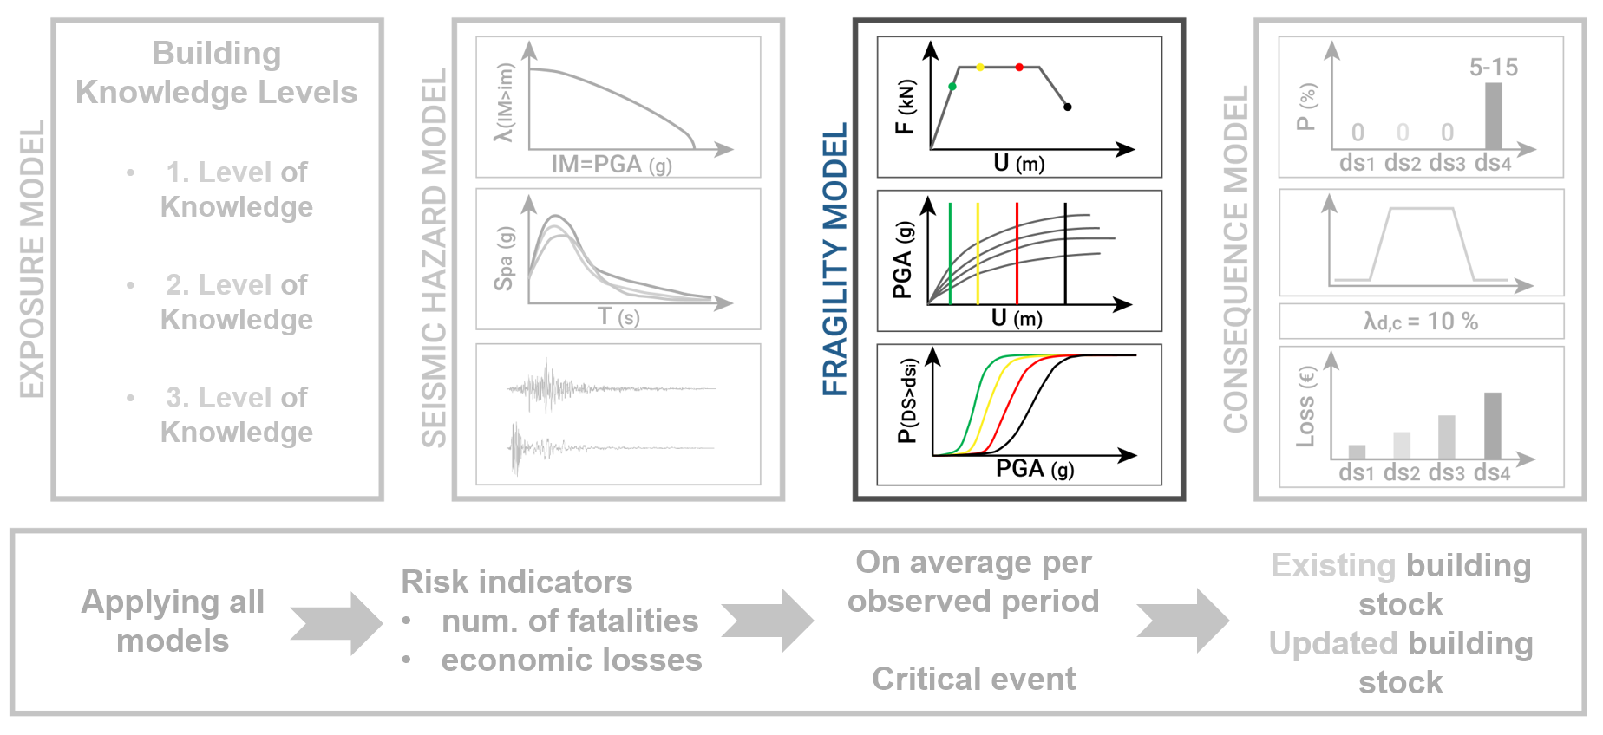
MODELS OF THE SEISMIC STRESS TEST
22.03.2021
3

Slide 7
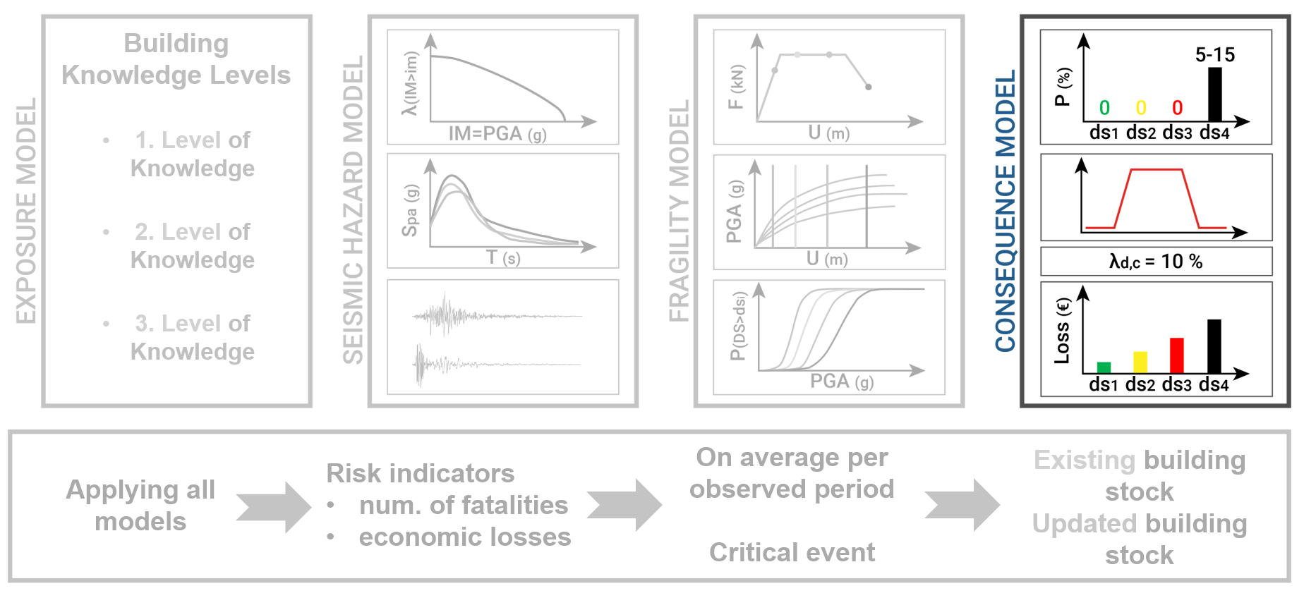
MODELS OF THE SEISMIC STRESS TEST
22.03.2021
3

Slide 8
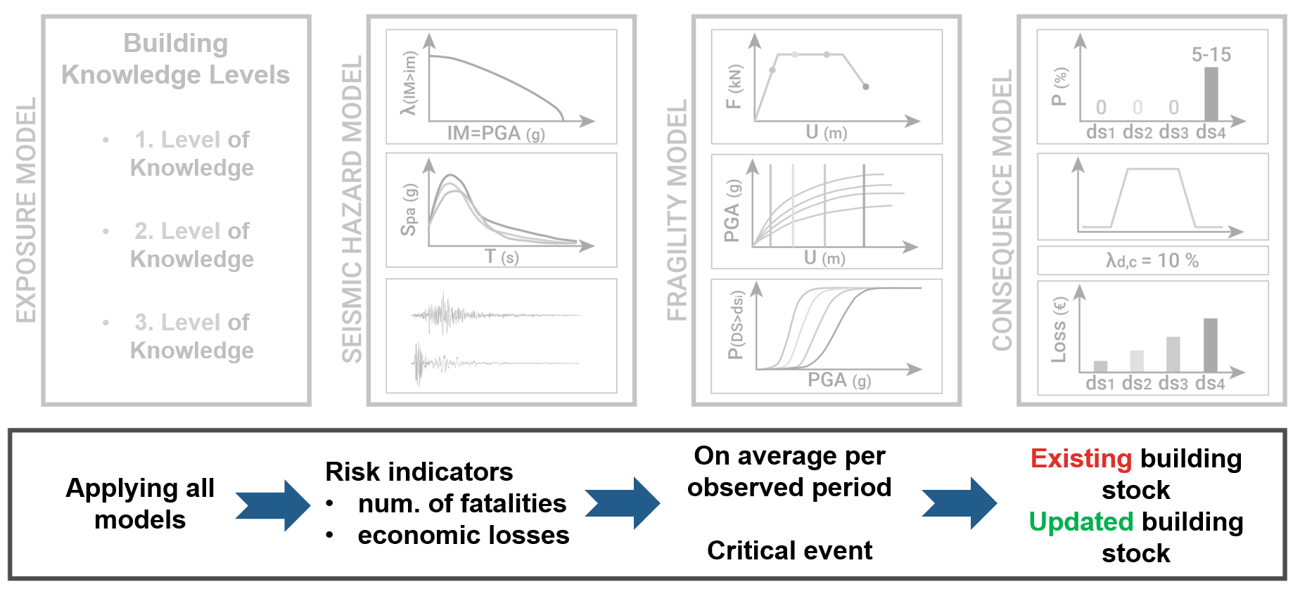
MODELS OF THE SEISMIC STRESS TEST
22.03.2021
3

Slide 9
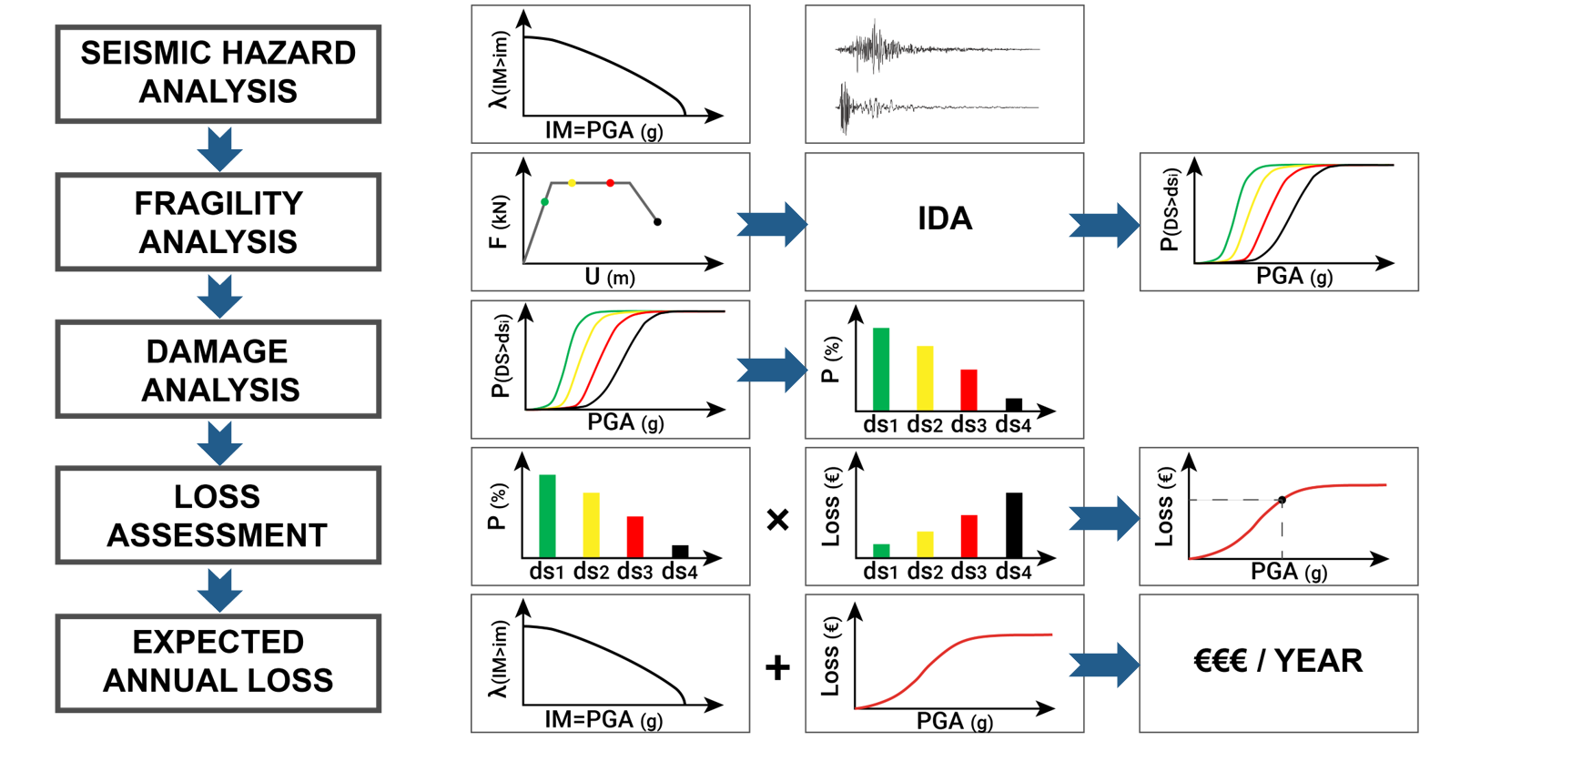
METHODOLOGY - ANALYSIS
22.03.2021
4

Slide 10
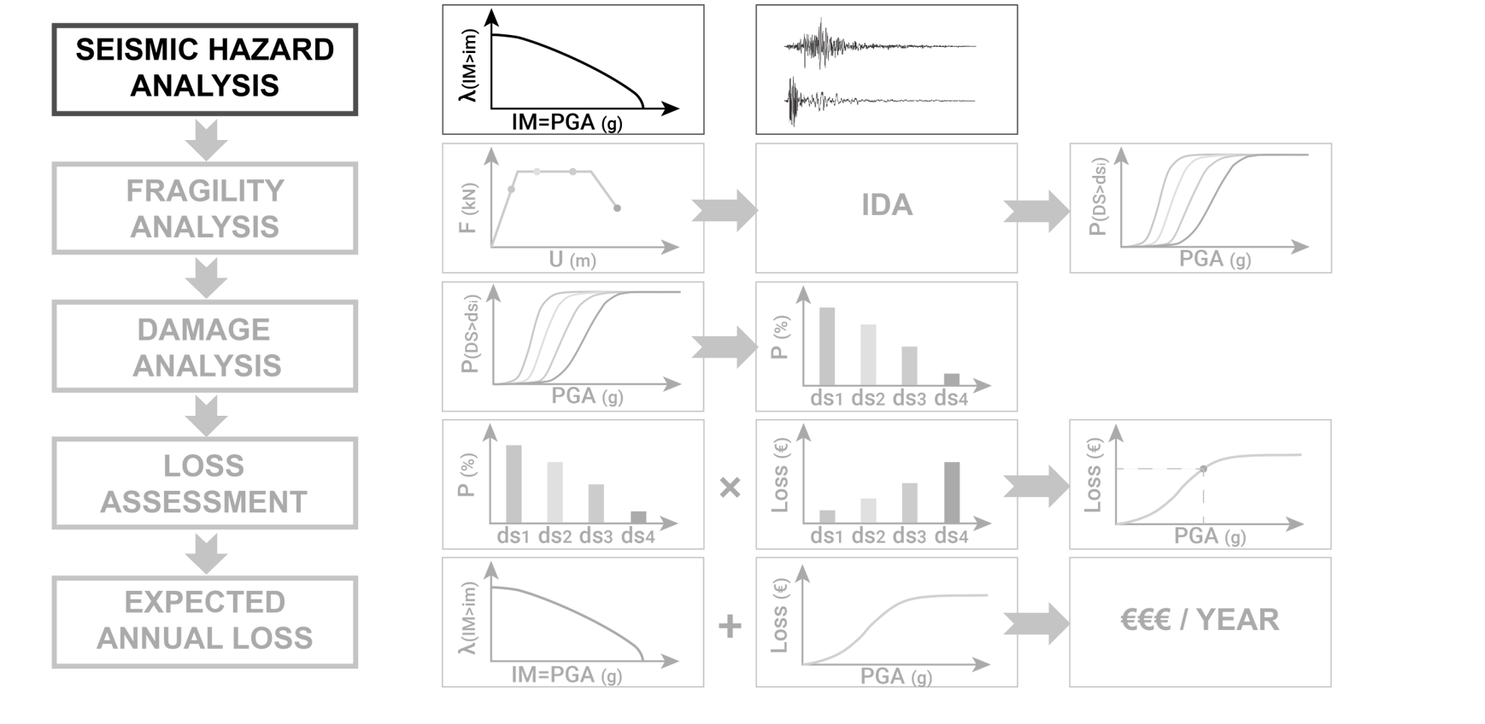
METHODOLOGY - ANALYSIS
22.03.2021
4

Slide 11
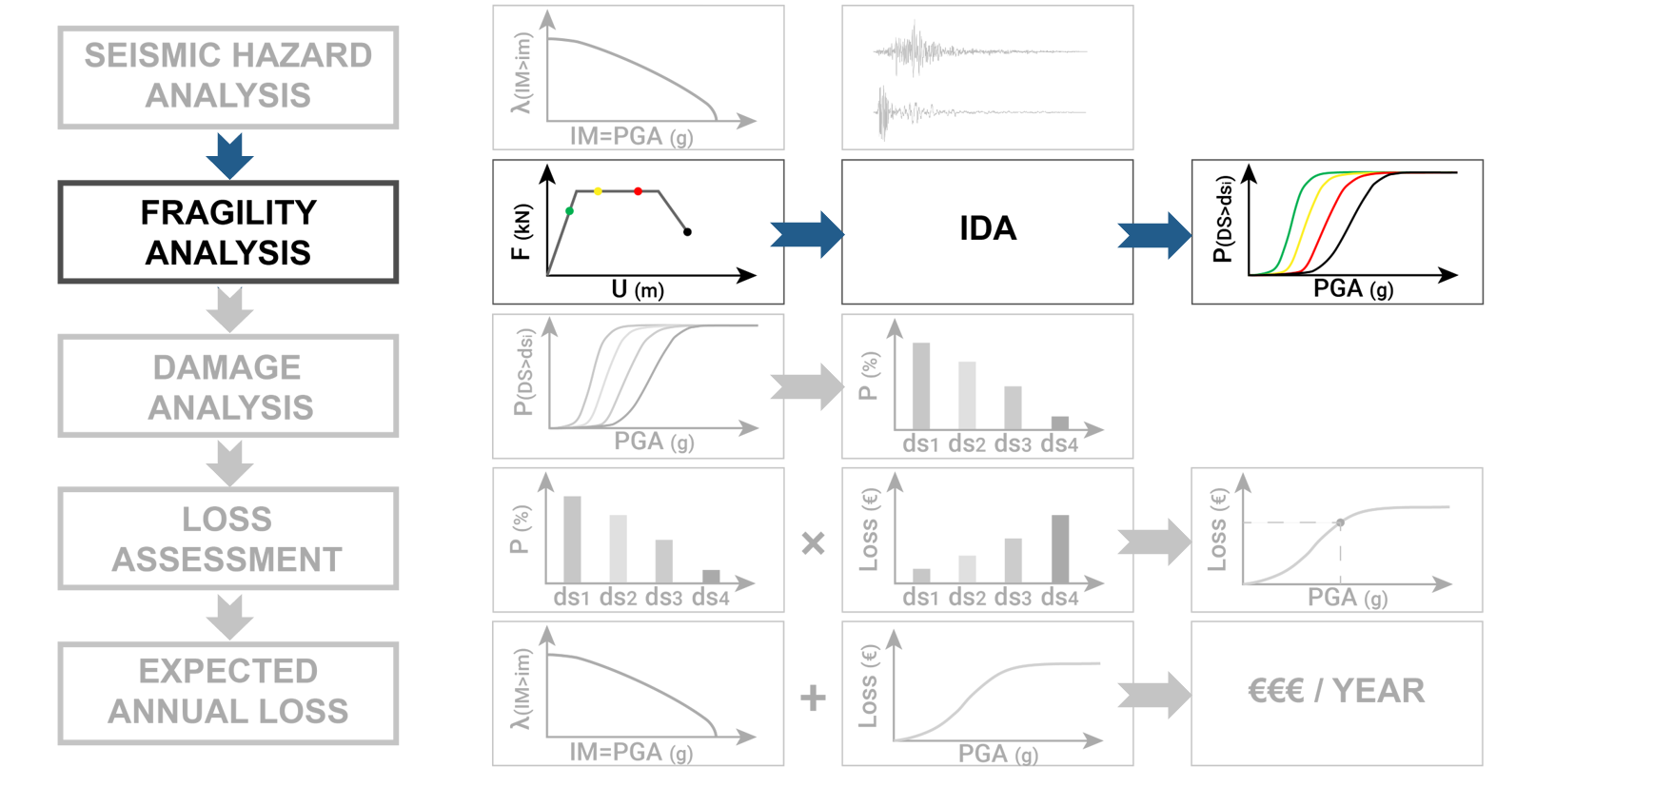
METHODOLOGY - ANALYSIS
22.03.2021
4

Slide 12
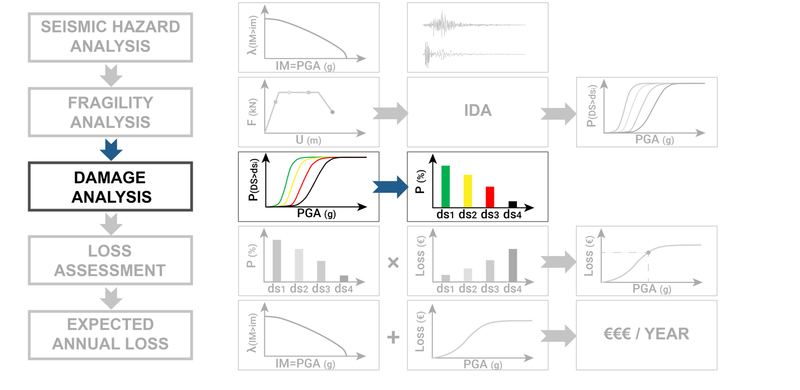
METHODOLOGY - ANALYSIS
22.03.2021
4

Slide 13
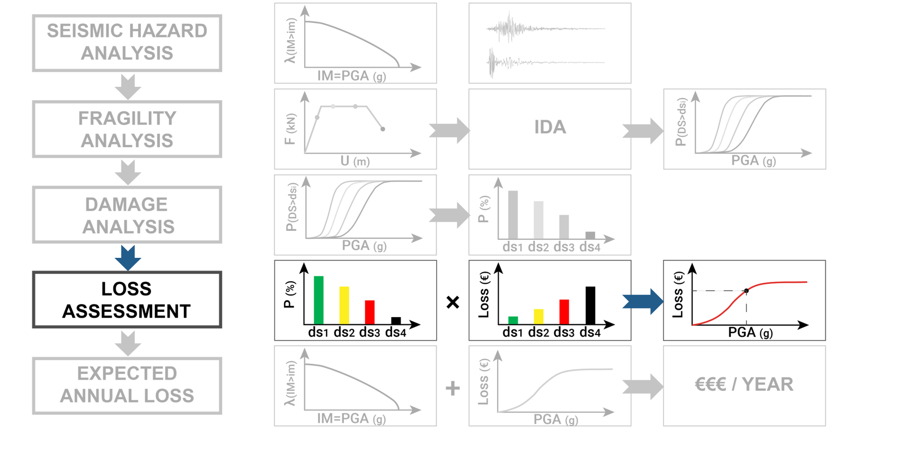
METHODOLOGY - ANALYSIS
22.03.2021
4

Slide 14
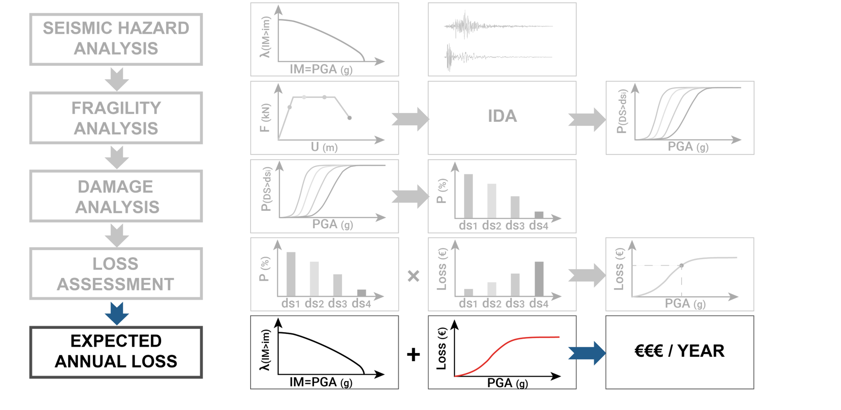
METHODOLOGY - ANALYSIS
22.03.2021
4

Slide 15
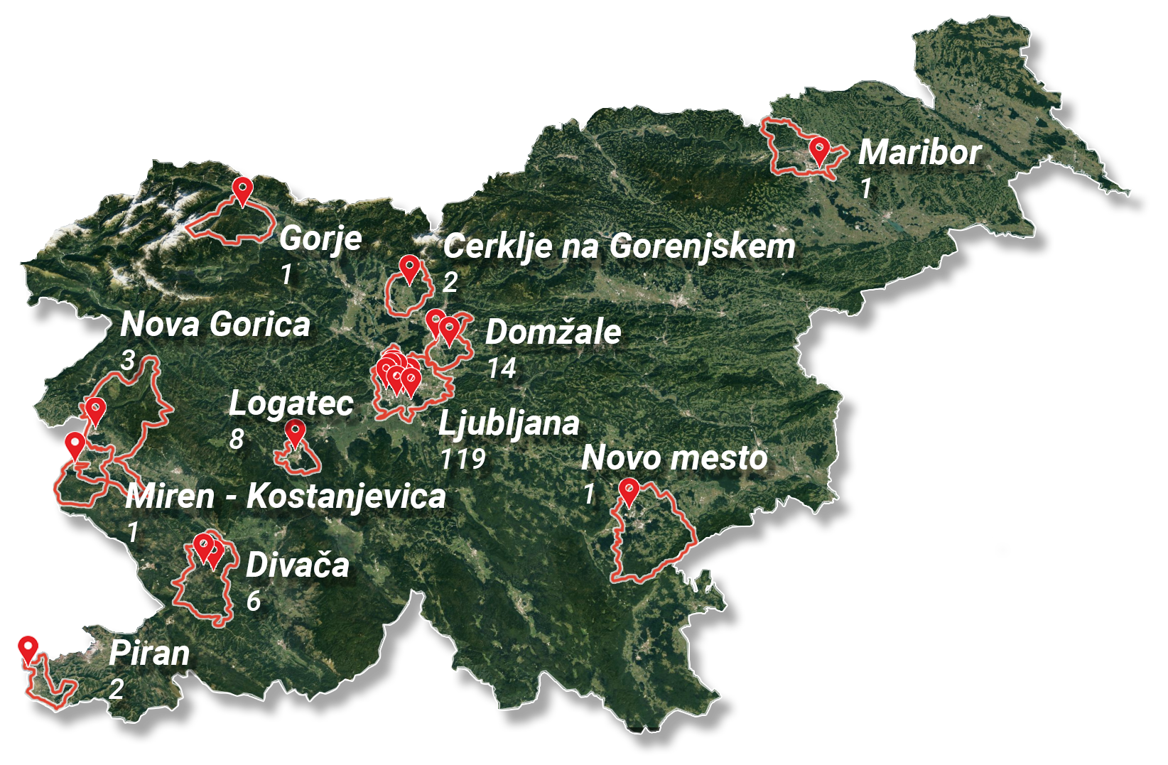
UL BUILDING STOCK OVERVIEW
Data provided by the University of Ljubljana:
the building stock includes 156 buildings or 228 building parts,
estimated total real estate value 253,000,000 EUR,
facilities found in 11 municipalities,
almost 38.000 enrolled students,
more than 6.000 employees.
22.03.2021
5

Slide 16
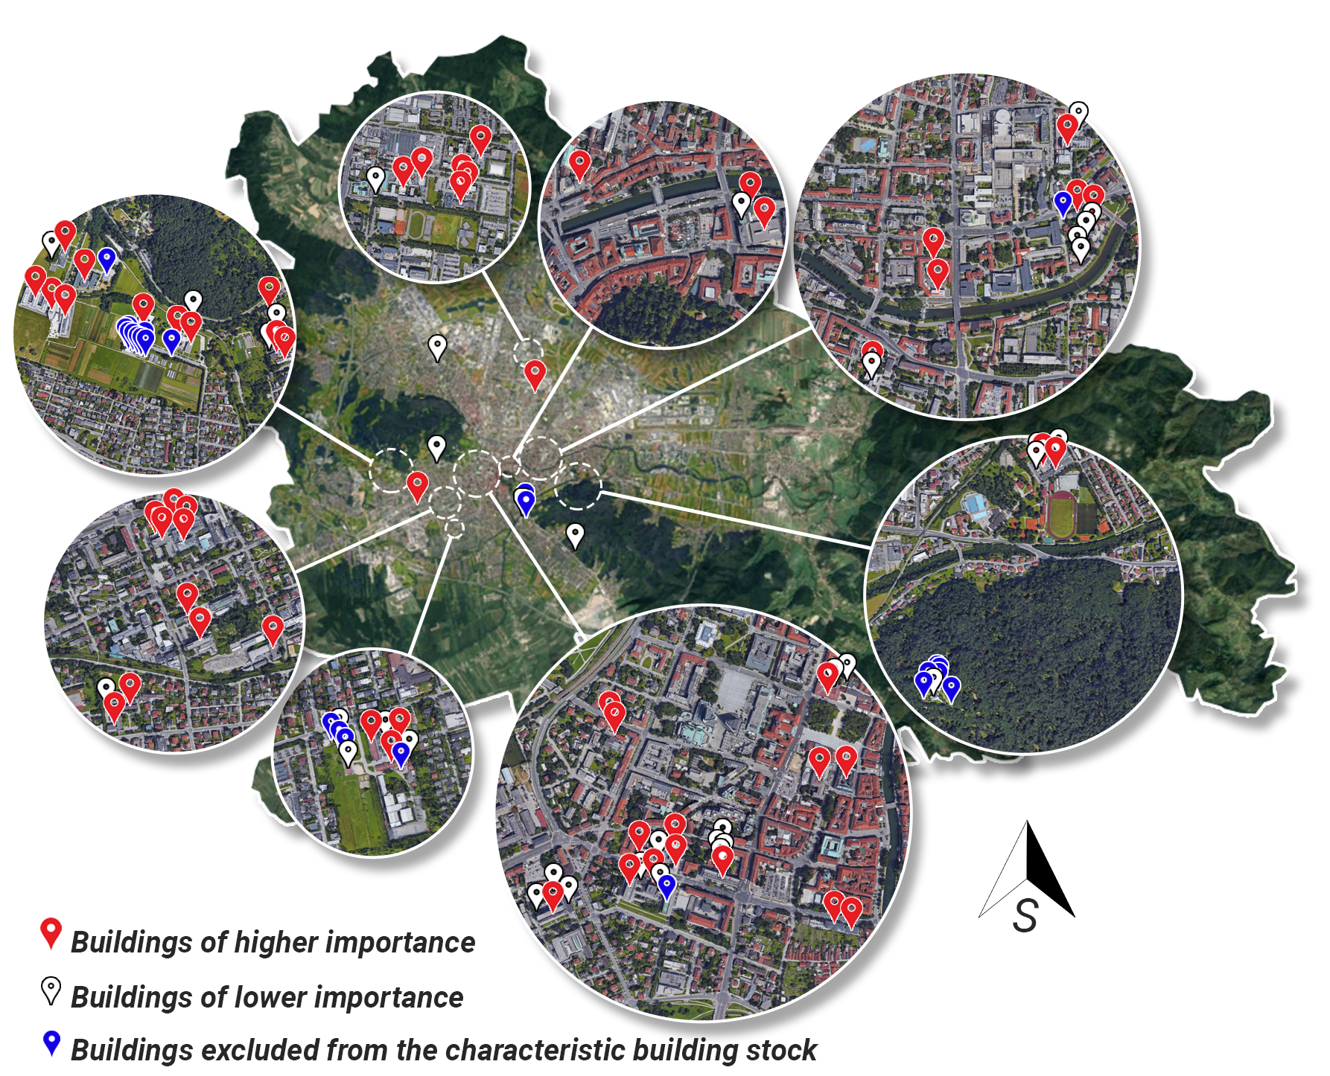
UL BUILDING STOCK OVERVIEW
The characteristic UL building stock:
buildings with the real estate value over 70.000 EUR,
103 buildings while still holding 99,8 % of the total real estate value of the UL building stock,
number of facilities in different Levels of Knowledge:
1. Level: 82 buildings,
2. Level: 18 buildings,
3. Level: 3 buildings.
N
22.03.2021
6

Slide 17
RESULTS OF THE STRESS TEST
Comparing the time-based seismic risk indicators in the case of the existing and the updated building stock:
average annual return period for loss of life among students: 6 years / 158 years,
average annual return period for loss of life among employees: 26 years / 411 years,
expected annual cost of repairing seismic damage: 1,040,000 EUR / 83,400 EUR.
THE SEISMIC RESILIENCE OF THE EXISTING UL BUILDING STOCK IS INSUFFICIENT.
22.03.2021
7

Slide 18
RESULTS OF THE STRESS TEST
Comparing the critical event seismic risk indicators in the case of the existing and the updated building stock:
expected number of fatalities among students: 34 deaths / 2 deaths,
expected number of fatalities among employees: 7 deaths / 1 death,
expected cost of repairing seismic damage: 136,700,000 EUR / 20,400,000 EUR.
THE SEISMIC RESILIENCE OF THE EXISTING UL BUILDING STOCK IS INSUFFICIENT.
22.03.2021
8

Slide 19
CONCLUSIONS
The seismic risk of the existing UL building stock it too high, as the seismic risk indicators far exceed the acceptable values:
the expected number of fatalities in 50 years by a factor of 10,
the number of fatalities in the critical event by a factor of 14,
the expected annual losses by a factor of 12,5 and
the total expected losses in the case of the critical event by a factor of 7,
the awareness exists, plans for constructing new faculties.
22.03.2021
9

Slide 20
THANK YOU FOR LISTENING
Jure.Starc@fgg.uni-lj.si
www.linkedin.com/in/jure-starc
The Institute of Structural Engineering, Earthquake Engineering and Construction IT
Co-authors: prof. Matjaž Dolšek Ph.D Matjaz.Dolsek@ikpir.fgg.uni-lj.si
assist. Anže Babič Ph.D Anže.Babic@ikpir.fgg.uni-lj.si
assist. Jure Žižmond Ph.D Jure.Zizmond@ikpir.fgg.uni-lj.si
Jure Starc, mag. inž. grad. Young researcher
22.03.2021
10

