Slide 1
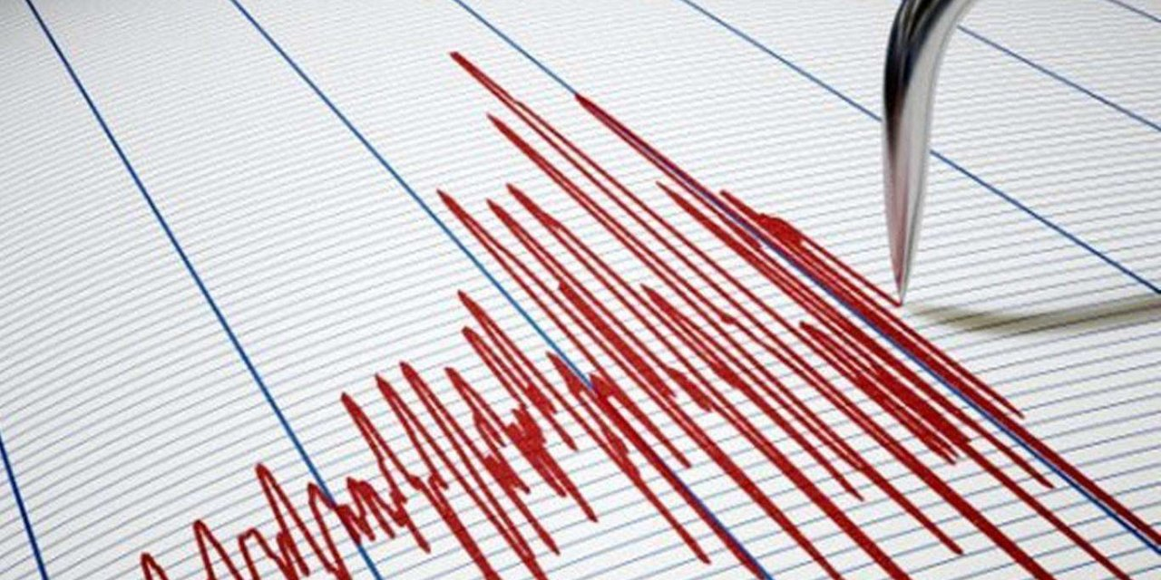
Istanbul Technical University
Department of Civil Engineering
CataLogIST
A MACHINE LEARNING FRAMEWORK FOR AUTOMATED GROUND MOTION PREDICTION
Authors
Moheldeen A. Hejazi Serra Tinbir Pooya G. khalifani Ali Sari
(Speaker) (Speaker)
Director of Omega-Risk and Associate professor, at Istanbul Technical University, Istanbul, Turkey, asari@itu.edu.tr
Ph.D. candidate, at Istanbul Technical University, Istanbul, Turkey, Pghaffari@itu.edu.tr
Ph.D. Student, at Istanbul Technical University, Istanbul, Turkey, hejazi19@itu.edu.tr
Graduate student, at Istanbul Technical University, Istanbul, Turkey, tinbir19@itu.edu.tr
Currently speaking: M. A. Hejazi Email: hejazi19@itu.edu.tr

Slide 2
Outline
A brief background
Turkish ground motion database (AFAD-TADAS)
The Proposed CatalogIST System
The machine learning model and its training for the prediction of future ground motions.
Is it significant? A discussion on the “why” and “How much”.
GMPEs degradation of accuracy through a comparison of two decades.
Currently speaking: M. A. Hejazi Email: hejazi19@itu.edu.tr

Slide 3
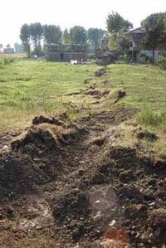
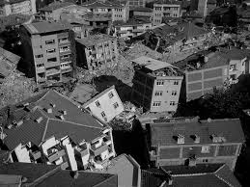
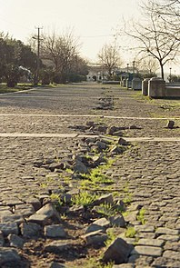
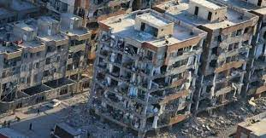
In 1999, an earthquake occurred at Kocaeli causing a huge life and property loss and triggering a massive shift and expansion in the country’s seismic network.
In the wake of the 1999’s earthquake, seismological studies and research gained momentum and the Turkish seismic network expanded drastically to address the periodic seismic activity of the North Anatolian Fault System (NAF).
Currently speaking: Serra TINBIR Email: tinbir19@itu.edu.tr

Slide 4
Seismic Background of Turkey Since 1939 (M>6 for any scale)
 | DATE | LOCATION | LIFE LOSSES | MAGNITUDE
1939-1948 | December 27, 1939 | Erzincan | 33000 | 7,9
 | December 13, 1941 | Muğla | 0-2 | 6,5
 | November 15, 1942 | Bigadiç, Balıkesir | 16 | 6,1
 | December 20, 1942 | Erbaa, Tokat | 3000 | 7,0
 | June 20, 1943 | Adapazarı | 336 | 6,6
 | November 27, 1943 | Kastamonu-Çankırı boundary | 4000 | 7,2
 | February 1, 1944 | Gerede, Bolu | 3959 | 7,2
 | October 6, 1944 | Ayvacık, Balıkesir | 30 | 6,8
1949-1958 | July 23, 1949 | Karaburun, İzmir | 7 | 6,6
 | August 17, 1949 | Karlıova, Bingöl | 450 | 6,7
 | August 13, 1951 | Kurşunlu, Çankırı | 50 | 6,9
 | March 18, 1953 | Yenice, Çanakkale | 265 | 7,2
 | July 16, 1955 | Söke, Aydın | 23 | 6,8
 | February 20, 1956 | Eskişehir | 1 | 6,4
 | May 26, 1957 | Mudurnu, Bolu | 52 | 7,1
 | April 24-25, 1957 | Fethiye, Muğla | 19 | 7,1
 | April 24-25, 1957 | Ölüdeniz |  | 7,3
1959-1968 | September 18, 1963 | Marmara Denizi | 1 | 6,3
 | October 6, 1964 | Manyas, Balıkesir | 23 | 7,0
 | August 19, 1966 | Varto, Muş |  | 6,9
 | July 22, 1967 | Mudurnu, Bolu | 89 | 7,2
 | September 3, 1968 | Amasra açıkları, Bartın, Zonguldak | 29 | 6,5
1969-1978 | March 28, 1969 | Alaşehir, Manisa | 53 | 6,5
 | March 28, 1970 | Gediz, Kütahya | 1086 | 7,2
 | May 22, 1971 | Bingöl | 878 | 6,8
 | September 6, 1975 | Lice, Diyarbakır | 2385 | 6,6
 | November 24, 1976 | Muradiye, Van | 3840 | 7,5
 | DATE | LOCATION | LIFE LOSSES | MAGNITUDE
1979-1988 | July 5, 1983 | Biga, Çanakkale | 5 | 6,1
 | October 30, 1983 | Narman, Erzurum | 1155 | 6,9
 | September 18, 1984 | Şenkaya, Erzurum | 3 | 6,4
1989-1998 | March 13, 1992 | Erzincan | 653 | 6,8
 | October 1, 1995 | Dinar, Afyonkarahisar | 90 | 6,1
 | June 27, 1998 | Ceyhan, Adana | 146 | 6,2
1999-2008 | August 17, 1999 | Gölcük, Kocaeli | 17118 | 7,4
 | November 12, 1999 | Düzce | 894 | 7,2
 | June 6, 2000 | Orta, Çankırı | 3 | 6,1
 | February 3, 2002 | Sultandağı | 44 | 6,5
 | January 27, 2003 | Pülümür, Tunceli | 1 | 6,1
 | May 1, 2003 | Bingöl | 177 | 6,4
2009-2018 | March 8, 2010 | Karakoçan, Elâzığ | 41 | 6,1
 | October 23, 2011 | Tabanlı, Van | 604 | 7,2
 | January 8, 2013 | Aegean Sea (Çanakkale) | 0 | 6,2
 | May 24, 2014 | Aegean Sea (Gökçeada) | 0 | 6,9
 | June 12, 2017 | Aegean Sea (Karaburun) | 0 | 6,3
 | July 21, 2017 | Aegean Sea (Bodrum) | 0 | 6,6
2019- | January 24, 2020 | Sivrice, Elazığ | 41 | 6,8
 | October 30, 2020 | Aegean Sea | 114 (Turkey) | 6,9
 | October 30, 2020 | Aegean Sea | 2 (Greece) | 6,6
Currently speaking: Serra TINBIR Email: tinbir19@itu.edu.tr

Slide 5
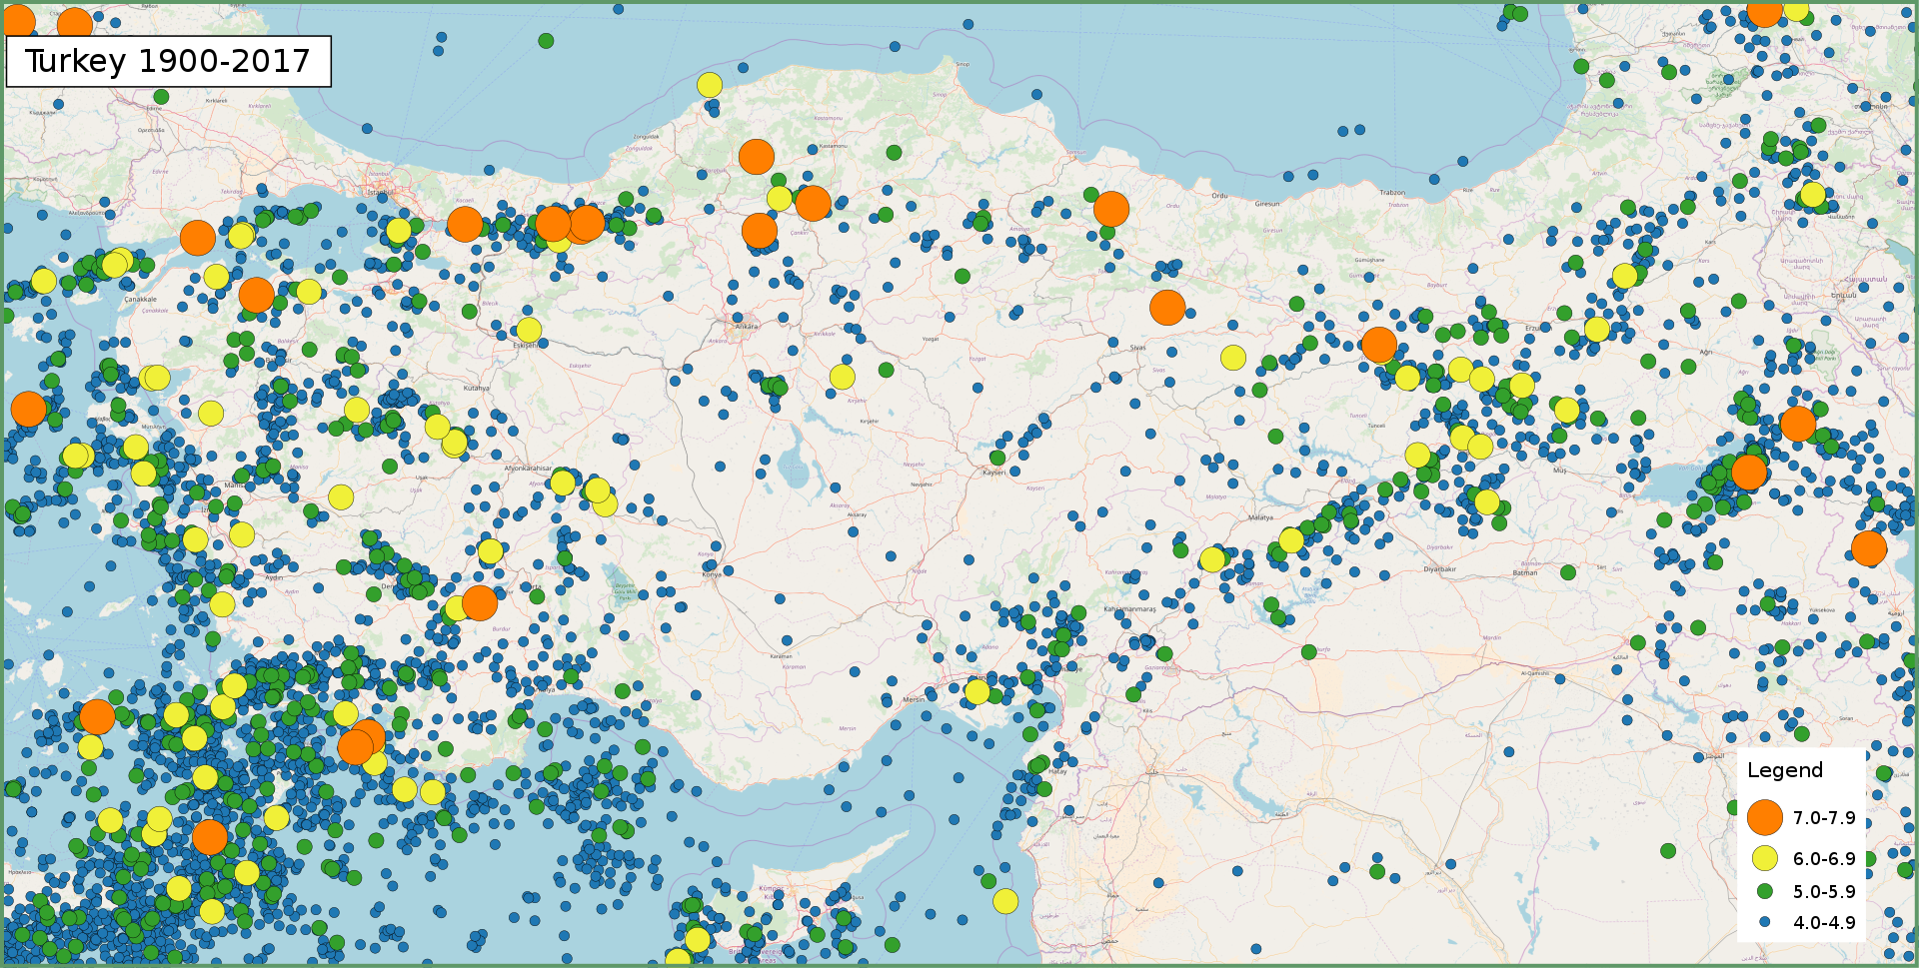
Earthquakes Occurred in Turkey Between 1900 - 2017
Currently speaking: Serra TINBIR Email: tinbir19@itu.edu.tr

Slide 6
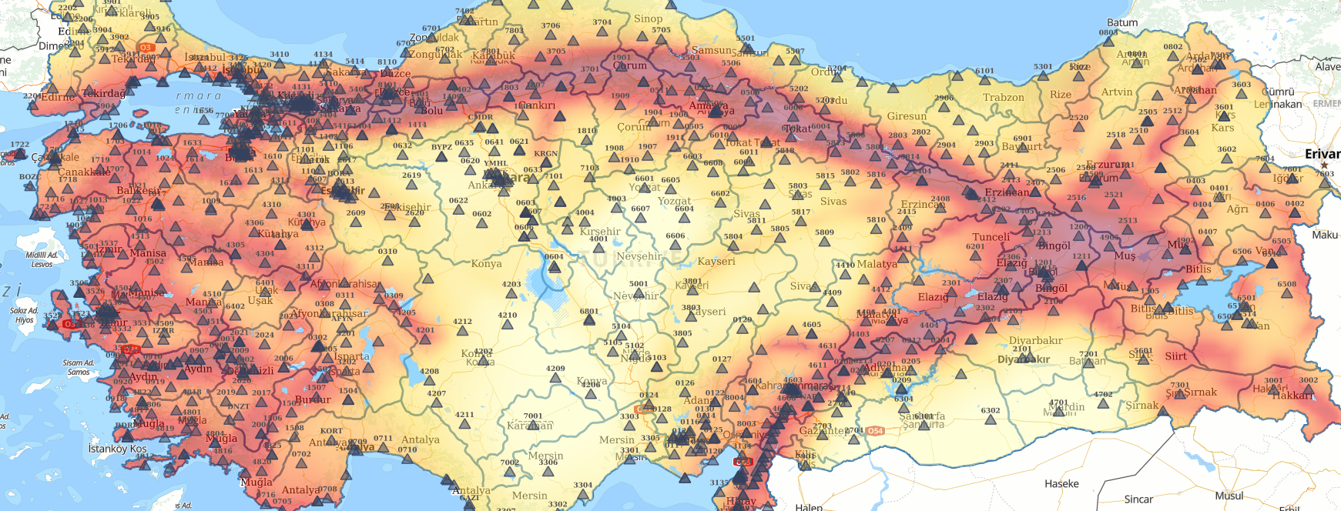
Accelerometric Stations and Seismic Hazard Map of Turkey
Currently speaking: Serra TINBIR Email: tinbir19@itu.edu.tr

Slide 7
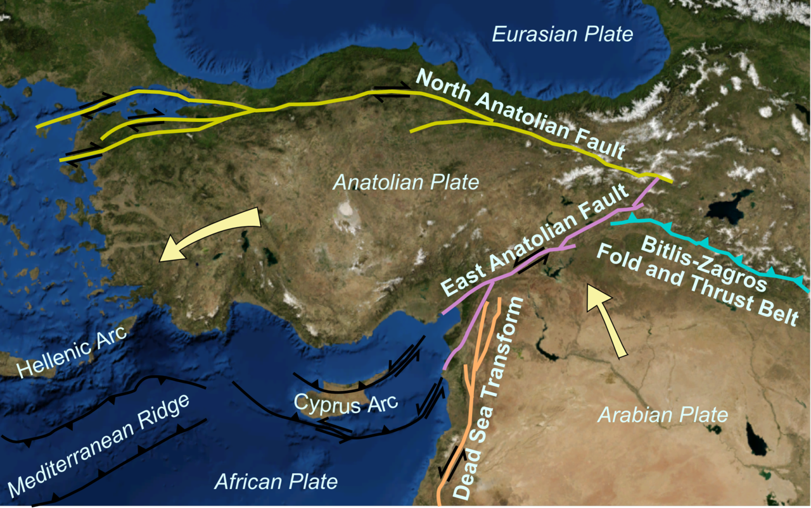
Turkey’s Location on Tectonic Plates
Currently speaking: Serra TINBIR Email: tinbir19@itu.edu.tr

Slide 8
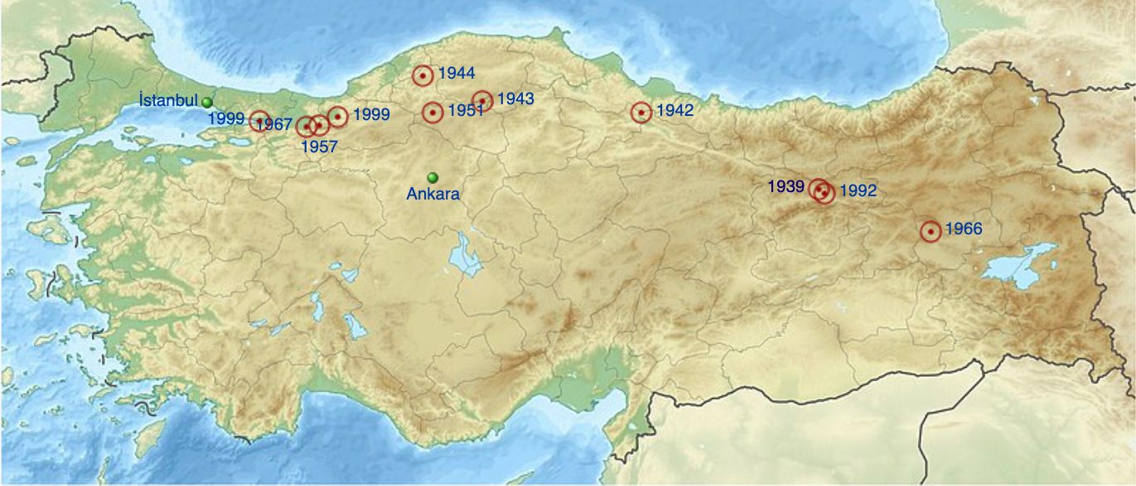
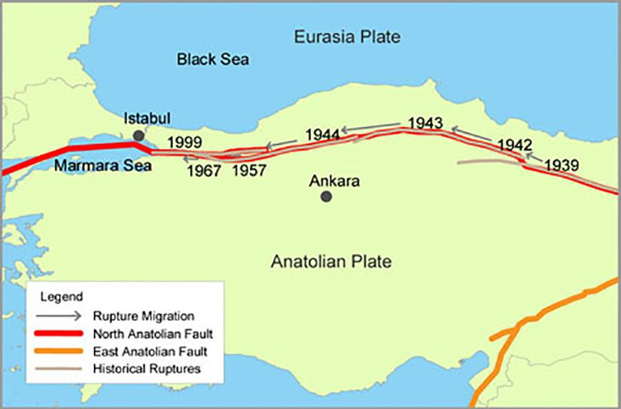
Major Fault Systems of Turkey
Kocaeli
Earthquake migration of NAF:
Major earthquakes occurred on North Anatolian Fault (NAF) since 1939:
1939 Erzincan
1942 Tokat
1943 Kastamonu
1944 Bolu
1951 Çankırı
1957 Bolu
1966 Muş
1967 Bolu
1999 Kocaeli & Düzce
Currently speaking: Serra TINBIR Email: tinbir19@itu.edu.tr

Slide 9
Major Fault Systems of Turkey
Aegean Fault Zone
East Anatolian Fault
Currently speaking: Serra TINBIR Email: tinbir19@itu.edu.tr

Slide 10
Ground Motion Prediction Equation Development
General formula of a GMPE:
$$\log{Y_{ij}=f\left(M_{i},r_{ij},\overline{θ}\right)+ε_{ij}}$$
Defined Site Parameters:
modeling the relation
Ground Motion Parameters:
Magnitudes (M_{w}, M_{s}, M_{L} basically)
Source-to-site distances (R_{epi}, R_{rup}, R_{JB}, etc.)
Local site conditions (Soil class, V_{S,30})
Earthquake source characteristics
Fault mechanism
Wave propagation
Peak Ground Acceleration (PGA)
Peak Ground Velocity (PGV)
Spectral Accelerations (PSA)
Undefined site parameters:
Stress drop
Rupture propagation
Directivity
Basin effects
Nonlinear soil behavior
Currently speaking: Serra TINBIR Email: tinbir19@itu.edu.tr

Slide 11
Ground Motion Prediction Equation Development
A standard way to generate the GMPEs from the recorded strong-motion data is using regression analysis with fixed or mixed effect, for inter and intra-event variability.
Why more comprehensive methods are needed instead of regression analyses?
Parameters have nonlinear relationship with each other
Numerous limitations of statistical techniques
Regression analyses uses pre-defined linear/nonlinear set of equations
Assumption of normality of residuals
Limited ability of simulating complex behavior of ground motion parameters
Machine Learning / Artificial Intelligence
techniques will be more comprehensive for more accurate estimations.
Currently speaking: Serra TINBIR Email: tinbir19@itu.edu.tr

Slide 12
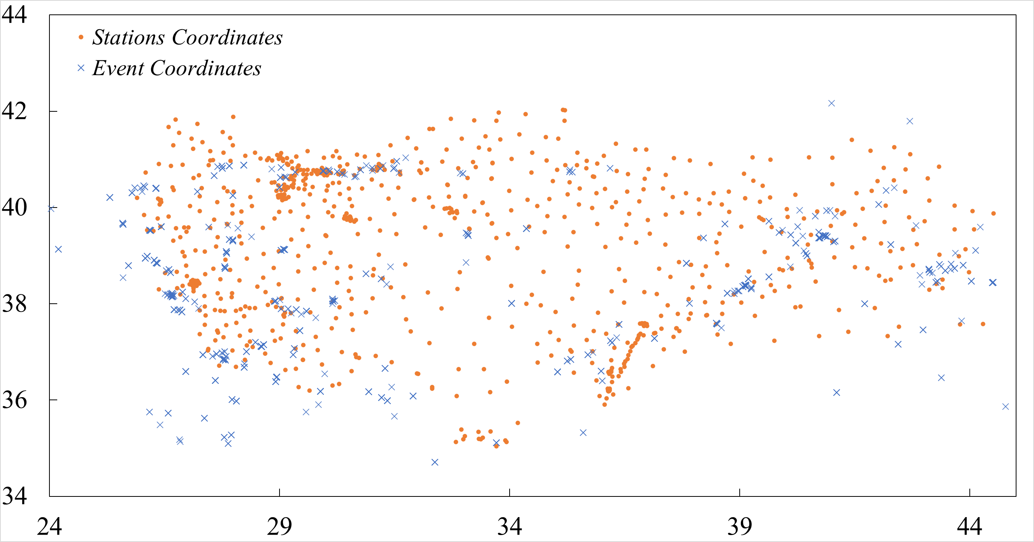
The AFAD-TADAS Database
Following the 1999’s M_{w}=7.4 Earthquake the network coverage expanded drastically with 799 new stations across the country.
Currently speaking: M. A. Hejazi Email: hejazi19@itu.edu.tr

Slide 13
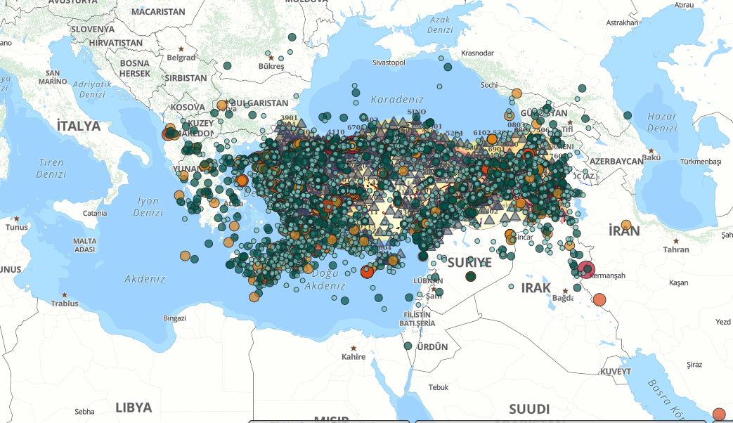
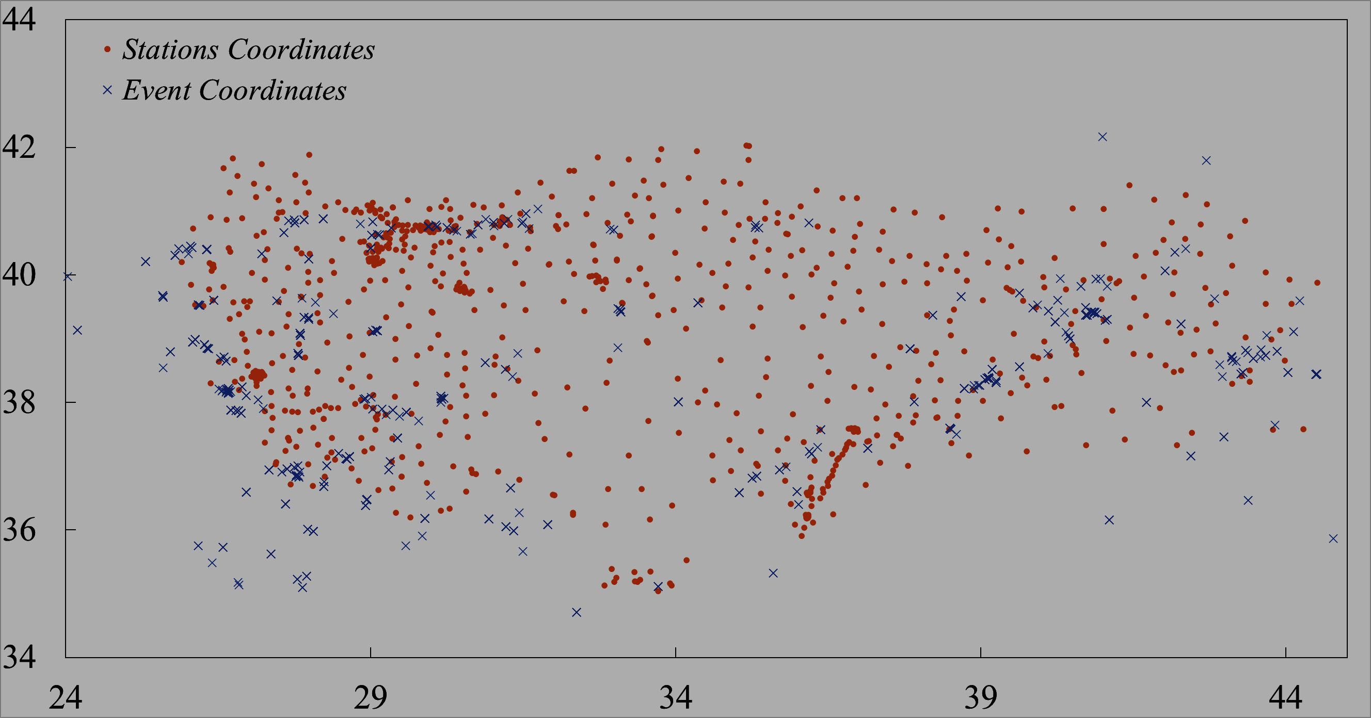
The AFAD-TADAS Database
Following the 1999’s M_{w}=7.4 Earthquake the network coverage expanded drastically with 799 new stations across the country.
The data quantity: has witnessed exponential surge with 80k records, 77% of which in the last 5 years
Currently speaking: M. A. Hejazi Email: hejazi19@itu.edu.tr

Slide 14
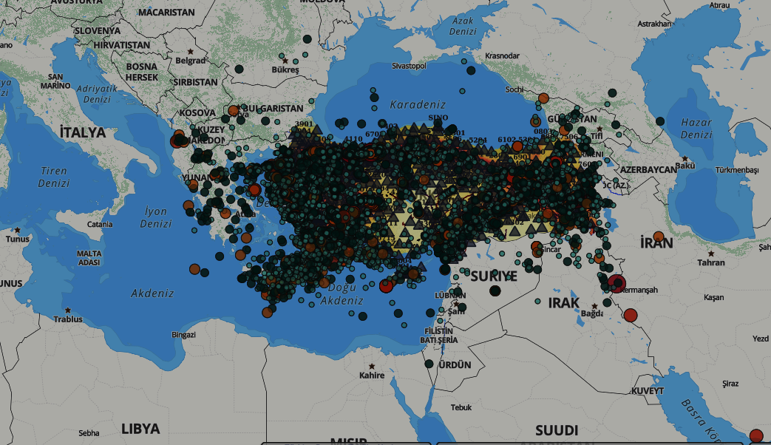
The AFAD-TADAS Database
Following the 1999’s M_{w}=7.4 Earthquake the network coverage expanded drastically with 799 new stations across the country.
The data quantity: has witnessed exponential surge.
In 2020, AFAD launched the Turkish Accelerometric Database and Analysis System (TADAS) which provides access to records from 1976 with Daily updates and 5-day publication gaps for the new records.
Currently speaking: M. A. Hejazi Email: hejazi19@itu.edu.tr

Slide 15
New Data … New Insights
Data available (Up to 2003):
Data available (Up to 2021):
Currently speaking: M. A. Hejazi Email: hejazi19@itu.edu.tr

Slide 16
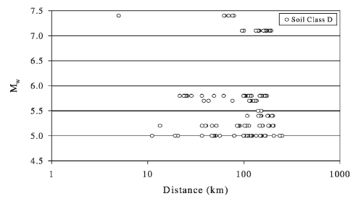
New Data … New Insights
Data available (Up to 2003):
Data available (Up to 2021):
Currently speaking: M. A. Hejazi Email: hejazi19@itu.edu.tr

Slide 17
New Data … New Insights
Data available (Up to 2003):
Data available (Up to 2021):
Currently speaking: M. A. Hejazi Email: hejazi19@itu.edu.tr

Slide 18
New Data … New Insights
Data available (Up to 2021):
Data available (2021 and Beyond):
Currently speaking: M. A. Hejazi Email: hejazi19@itu.edu.tr

Slide 19
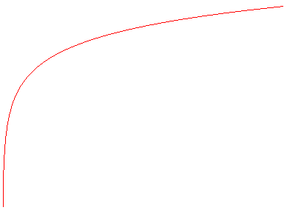
New Data … New Insights
Data available (Up to 2021):
Data available (2021 and Beyond):
Currently speaking: M. A. Hejazi Email: hejazi19@itu.edu.tr

Slide 20
The Question is:
How to adapt to such enormous data?
Currently speaking: M. A. Hejazi Email: hejazi19@itu.edu.tr

Slide 21
The Question is:
How to adapt to such enormous data?
The Proposed Model:
CataLogIST
Catalogues’ Intelligent System for Tectonics
Currently speaking: M. A. Hejazi Email: hejazi19@itu.edu.tr

Slide 22
The Proposed Model: Objectives
CataLogIST
Catalogues’ Intelligent System for Tectonics
Goals:
Adaptive; to different databases and geographical domains.
Automated; in terms of monitoring and processing the data, and updating the predictions
Accuracy and robustness.
Minimal computational cost.
Currently speaking: M. A. Hejazi Email: hejazi19@itu.edu.tr

Slide 23
The Proposed Model: Structure
Automated Data Monitoring System
ADMS
CataLogIST
Catalogues’ Intelligent System for Tectonics
Currently speaking: M. A. Hejazi Email: hejazi19@itu.edu.tr

Slide 24
The Proposed Solution:
Automated Data Monitoring System
ADMS
Data Processing System
DPS
CataLogIST
Catalogues’ Intelligent System for Tectonics
Currently speaking: M. A. Hejazi Email: hejazi19@itu.edu.tr

Slide 25
The Proposed Solution:
Automated Data Monitoring System
ADMS
Data Processing System
DPS
CataLogIST
Prediction Optimization System
Catalogues’ Intelligent System for Tectonics
POS
Currently speaking: M. A. Hejazi Email: hejazi19@itu.edu.tr

Slide 26
The Proposed Solution:
Automated Data Monitoring System
ADMS
Data Processing System
DPS
CataLogIST
Prediction Optimization System
Catalogues’ Intelligent System for Tectonics
POS
Structure Monitoring & Optimization System
SMOS
Currently speaking: M. A. Hejazi Email: hejazi19@itu.edu.tr

Slide 27
The Proposed Solution: ADMS
Automated Data Monitoring System
ADMS
Data Monitoring Unit (DMU)
Data Indexing Unit (DIU)
Data Retrieval Unit (DRU)
Unit | Criterion | Threshold
DMU | Time | Daily at 3:00 AM at IST local time (1:00 AM GMT)
DRU | Moment Magnitude | $$Mw≥6$$
 | Number of new events | 3
 | Number of new records | 40
Currently speaking: M. A. Hejazi Email: hejazi19@itu.edu.tr

Slide 28
The Proposed Solution: DPS, POS
Automated Data Monitoring System
ADMS
Data Processing System
DPS
Prediction Optimization System
POS
3844 records {80% training & 20% Testing}
Inputs | Outputs
Moment magnitude (>=5) | PGA
Vs30 | PGV
Epicentral distance (<=200 km) | PGD
Currently speaking: M. A. Hejazi Email: hejazi19@itu.edu.tr

Slide 29
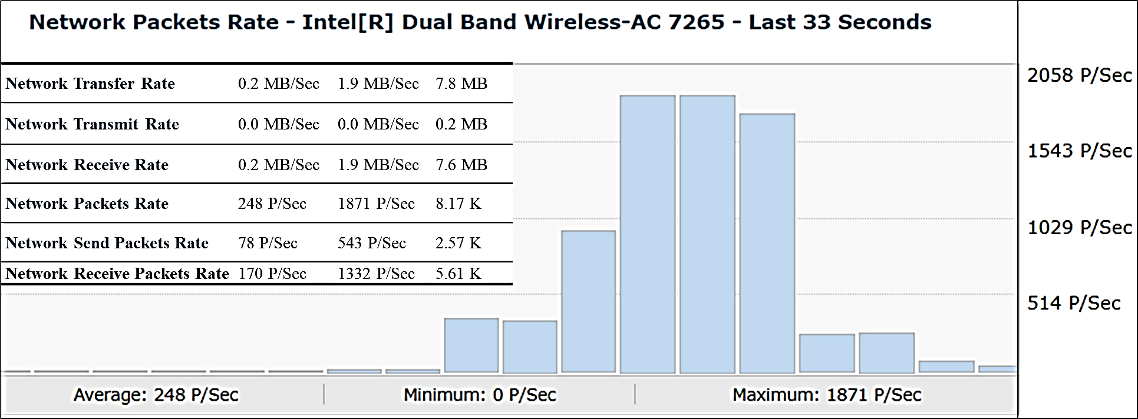
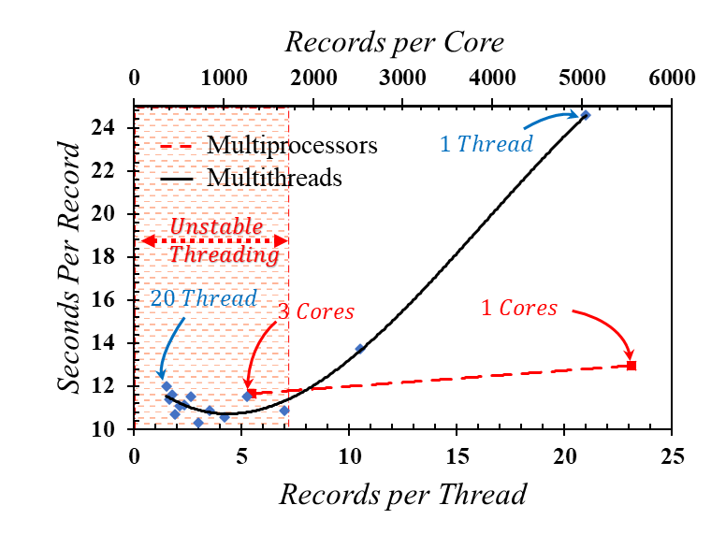
I/O bounded in the case of TADAS database
a typical 4 physical cores Intel(R) Core (TM) i7-8550U CPU @ 1.80GHz processor was used with 12 GB ram
Counter | DRU |  | DMU
 | Average | Maximum | Average | Maximum
Process CPU Usage | 0.6 % | 6.8 % | 0.7 % | 4.2 %
Process Memory Used | 1.52 GB | 1.56 GB | 890.8 MB | 900.0 MB
Process Thread Count | 86 | 90 | 86 | 88
Process Handle Count | 1755 | 1811 | 1951 | 1973
Process Data Rate | 0.0 MB/Sec | 1.1 MB/Sec | 0.0 MB/Sec | 0.9 MB/Sec
Currently speaking: M. A. Hejazi Email: hejazi19@itu.edu.tr

Slide 30
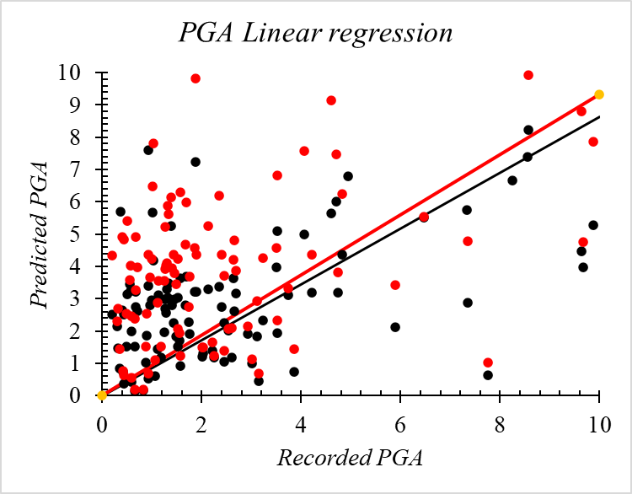
GMPEs degradation of accuracy through a comparison of two decades.
Ozbey model: regression GMPE with 2003 data
The proposed system was trained for the same data (on the right) and was compared to Ozbey, 2003 attenuation equation
2003 data (195 Records)
Currently speaking: M. A. Hejazi Email: hejazi19@itu.edu.tr

Slide 31
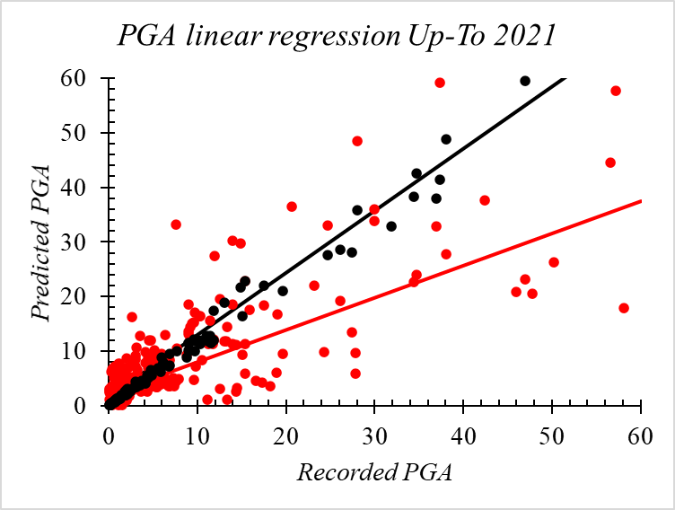
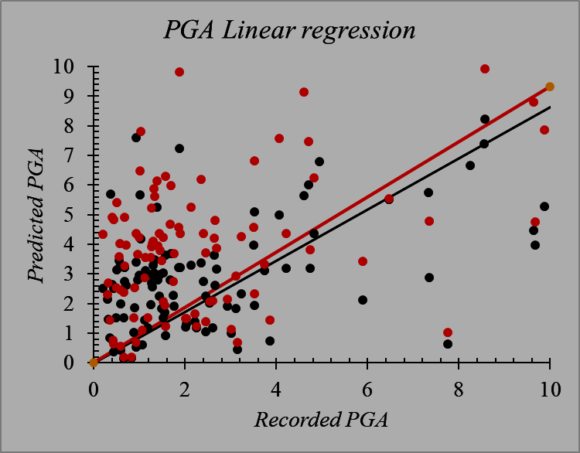
GMPEs degradation of accuracy through a comparison of two decades.
Ozbey model: regression-based GMPE with 2003 data
The proposed system was trained for the same data (on the right) and was compared to Ozbey, 2003 attenuation equation
The proposed system was trained for the up-to-date data (on the left) and was compared to Ozbey, 2003 attenuation equation
2021 data (3844 Records)
2003 data (195 Records)
Currently speaking: M. A. Hejazi Email: hejazi19@itu.edu.tr

Slide 32
Thank You
Currently speaking: M. A. Hejazi Email: hejazi19@itu.edu.tr

