Slide 1
PROPOSAL FOR A SUITABLE WORKFLOW FOR ASSESSING THE SEISMIC VULNERABILITY OF HISTORICAL BUILDINGS. ATLIXCO (PUEBLA, MÉXICO) AS A CASE STUDY
Rafael Ramírez Eudave*
Tiago Miguel Ferreira*
*ISISE, Department of Civil Engineering, University of Minho, Guimarães, Portugal

Slide 2
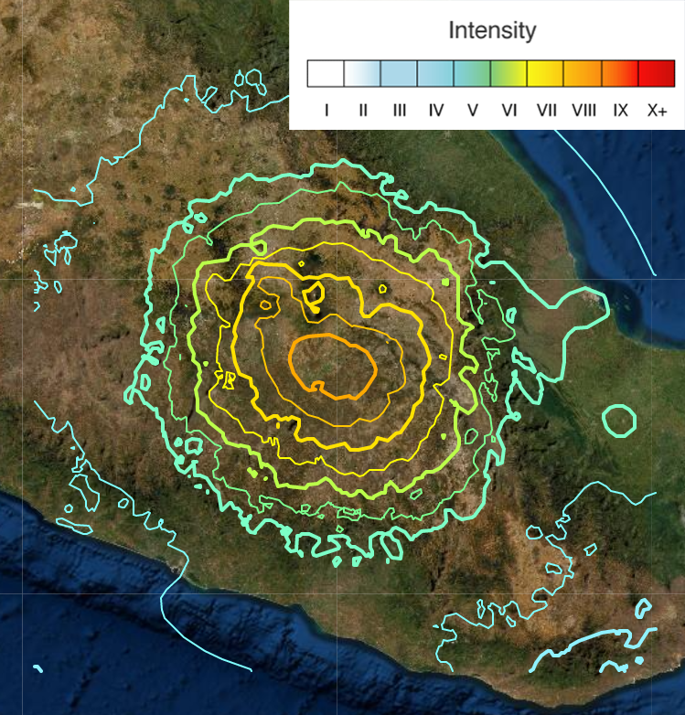
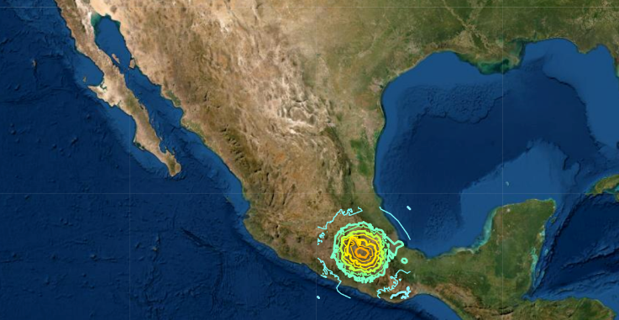
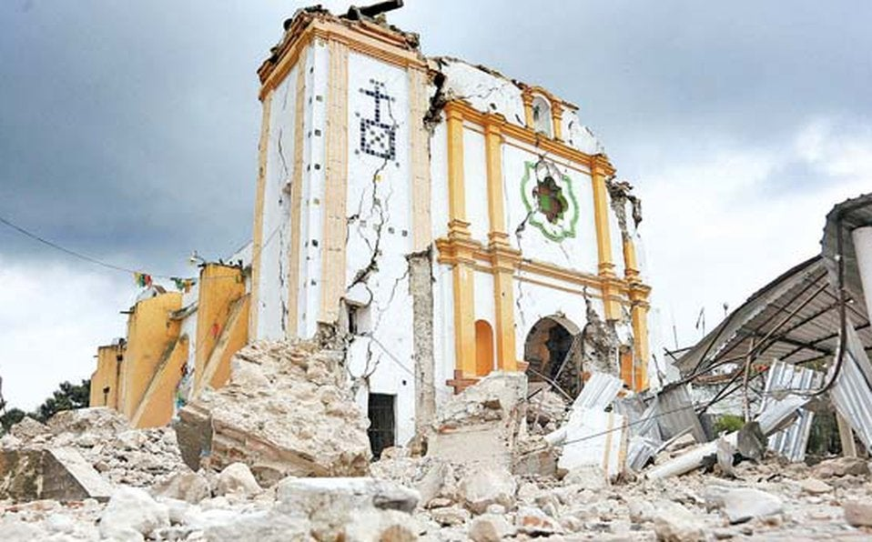
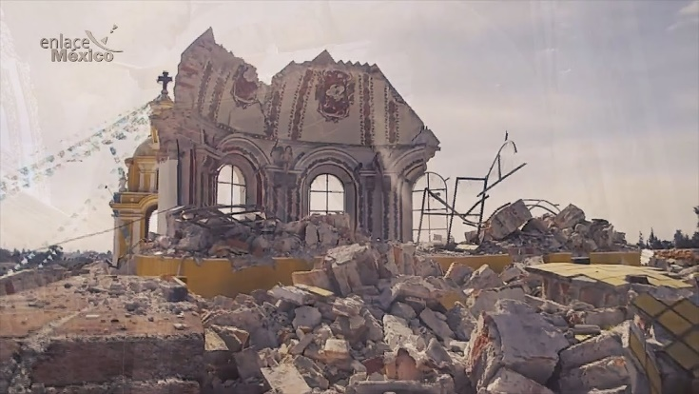
Introduction
7th of September, 2017. An M_{W}=8.2 seismic event hit the south of Mexico.
19th of September, 2017. An M_{W}=7.1 earthquake hit the country’s centre, affecting Mexico City and the surrounding areas.
Ca. 2,340 historical monuments suffered damages; an unknown number of minor historical constructions (namely houses) were seriously damaged too.
This work aims to present a suitable implementation of a simplified vulnerability approach for masonry constructions.
Intensities of the 19th of September, 2017 Earthquake.
Source: USGS https://earthquake.usgs.gov/earthquakes/eventpage/us2000ar20/map?historic-seismicity=true&shakemap-intensity=false

Slide 3
Introduction
Construction according to codes
Current code
Within its design lifespan
Reliable constructions
One of the most important challenges is to know how reliable are the existing constructions towards seismic events.
This assessment, however, is challenging due to the heterogeneity of constructions. It becomes even more difficult in the context of historical buildings, frequently built with masonry.
The wide spectrum of historic masonries makes it difficult to have standardised approaches for structural analysis.
Existing construction analyzed with reliable techniques
Construction according to codes
Current code
Exceeded its design lifespan
Constructions with an unknown reliability
Construction according to codes
Outdated code
Construction not according to codes

Slide 4
Motivation
Construction according to codes
Current code
Within its design lifespan
Reliable constructions
Proactively assessing the seismic vulnerability of existing constructions would permit to anticipate the effects of future events, helping to minimise material and human losses.
This would be possible through an large-scale, economic and easy approach, suitable for including extensive sets of minor constructions.
Suitable approach
+
suitable implementation
Existing construction analyzed with reliable techniques
Construction according to codes
Current code
Exceeded its design lifespan
Constructions with an unknown reliability
Construction according to codes
Outdated code
Construction not according to codes

Slide 5
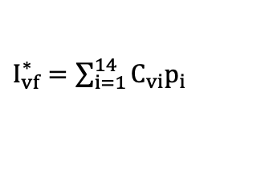
Vulnerability Index Method
Parameters | Class, C_{vi} |  |  |  | Weight | Weight | Relative weight
 | A | B | C | D | P_{i} | P_{i}
Group 1. Façade geometry, openings and interaction |  |  |  |  |  |  | 16.7/100
FP1. Geometry of façade | 0 | 5 | 20 | 50 | 0.50
FP2. Maximum slenderness | 0 | 5 | 20 | 50 | 0.50
FP3. Area of openings | 0 | 5 | 20 | 50 | 0.50
FP4. Misalignment of openings | 0 | 5 | 20 | 50 | 0.50
FP5. Interaction between continuous façades | 0 | 5 | 20 | 50 | 0.25
Group 2. Masonry materials and conservation |  |  |  |  |  |  | 31.5/100
FP6. Quality of materials | 0 | 5 | 20 | 50 | 2.00
FP7. State of conservation | 0 | 5 | 20 | 50 | 2.00
FP8. Replacement of original flooring system | 0 | 5 | 20 | 50 | 0.25
Group 3. Connection efficiency to other structural elements |  |  |  |  |  |  | 33.3/100
FP9. Connection to orthogonal walls | 0 | 5 | 20 | 50 | 2.00
FP10. Connection to horizontal diaphragms | 0 | 5 | 20 | 50 | 0.50
FP11. Impulsive nature of the roofing system | 0 | 5 | 20 | 50 | 2.00
Group 4. Conservation status and other elements |  |  |  |  |  |  | 18.5/100
FP12. Elements connected to the façade | 0 | 5 | 20 | 50 | 0.50
FP13. Improving elements | 0 | 5 | 20 | 50 | -2.00
It was originally presented in Italy (GNDT, 1994). It permits to assess the seismic vulnerability of masonry constructions based on a set of material and geometrical parameters that influence their seismic behaviour.
This approach inspired a variation aimed to assess the vulnerability of a construction based on parameters of the façades.
The sum of the products of the class (C_{vi}) and weight of each parameter (p_{i}) permits to calculate a Preliminar Vulnerability Index (I*_{vf}).
$I_{vf}^{∗}=\sum_{i=1}^{14}{C_{vi}p_{i}}$

Slide 6
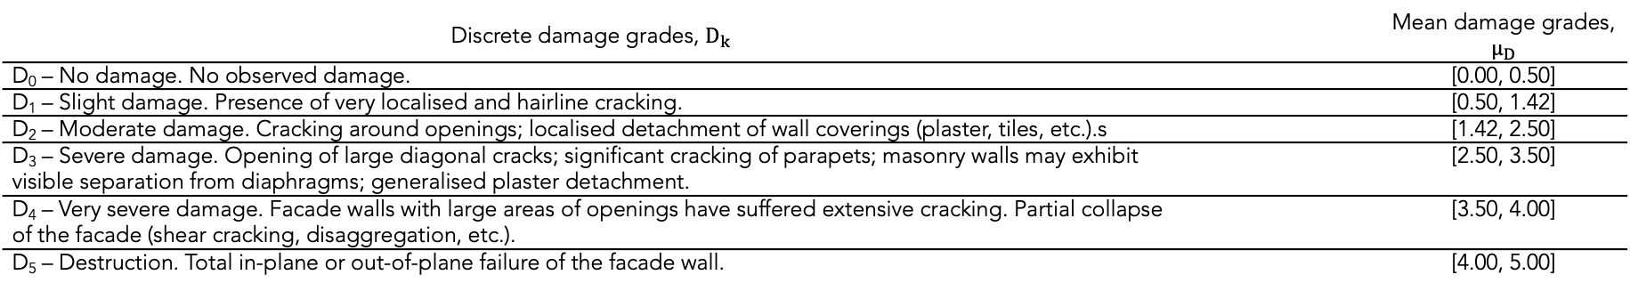
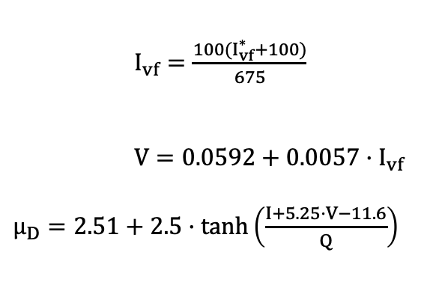
Vulnerability Index Method
$I_{vf}=\frac{{100(I}_{vf}^{∗}+100)}{675}$
$V=0.0592+0.0057·I_{vf}$
$µ_{D}=2.51+2.5·\tanh\left(\frac{I+5.25·V−11.6}{Q}\right)$
Besides the value individually calculated for the buildings (V), the use of a determined seismic intensity (I) and a ductility factor (Q) permit to estimate a damage grade (µ_{D}).
The mean damage grade ranges are associated to discrete levels (D_{k}) that qualitatively describe the situation of a building after the seismic event. This information permits to have damage scenarios for different seismic intensities.
Discrete damage grades, $D_{k}$ |  | Mean damage grades, $µ_{D}$
D₀ – No damage. No observed damage. |  | [0.00, 0.50]
D₁ – Slight damage. Presence of very localised and hairline cracking. |  | [0.50, 1.42]
D₂ – Moderate damage. Cracking around openings; localised detachment of wall coverings (plaster, tiles, etc.).s |  | [1.42, 2.50]
D₃ – Severe damage. Opening of large diagonal cracks; significant cracking of parapets; masonry walls may exhibit visible separation from diaphragms; generalised plaster detachment. |  | [2.50, 3.50]
D₄ – Very severe damage. Facade walls with large areas of openings have suffered extensive cracking. Partial collapse of the facade (shear cracking, disaggregation, etc.). |  | [3.50, 4.00]
D₅ – Destruction. Total in-plane or out-of-plane failure of the facade wall. |  | [4.00, 5.00]

Slide 7
Workflow for the Vulnerability Index Method implementation
In order to optimise the data acquisition for feeding the Vulnerability Index Method, a workflow for supporting the process of data acquisition was designed. This approach includes the use of Geographic Information Systems (GIS) as the main database; cloud storage; and a smartphone app devoted to the capture of information in the database. The use of open-source tools and software would permit to maximise the collaborative work of numerous agents.

Slide 8
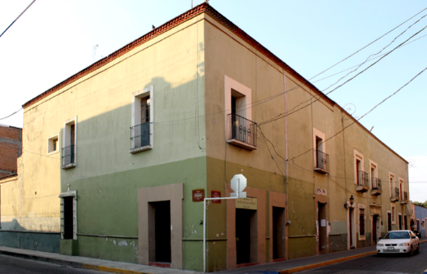
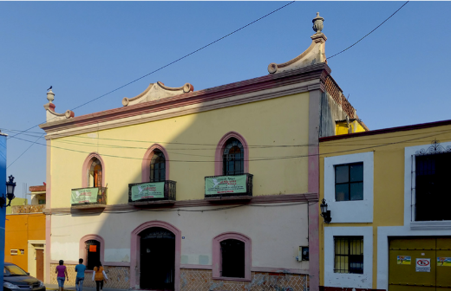
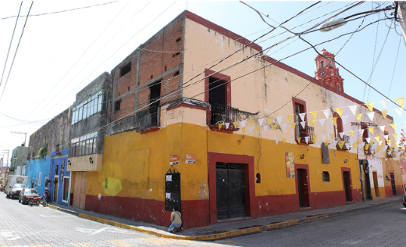
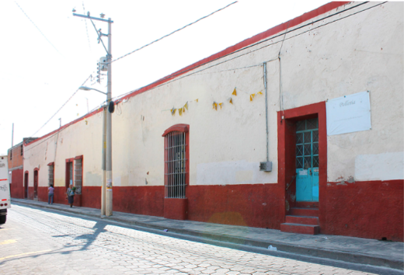
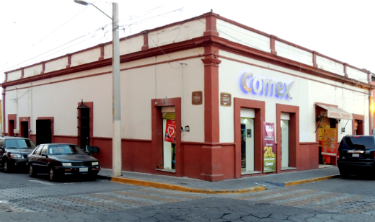
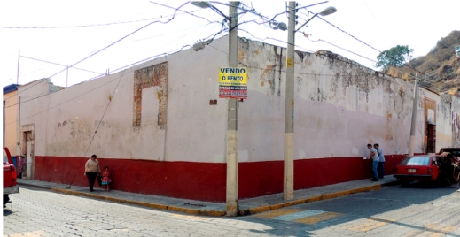
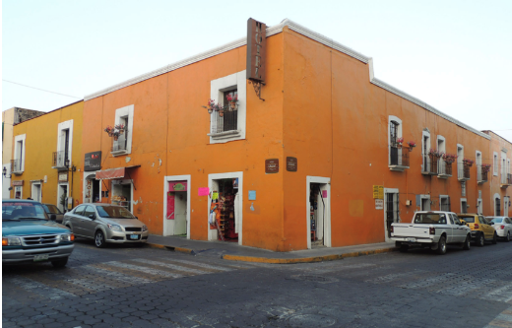
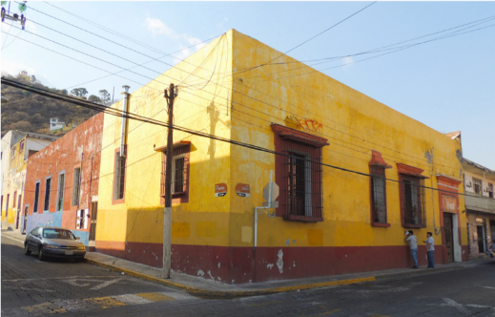
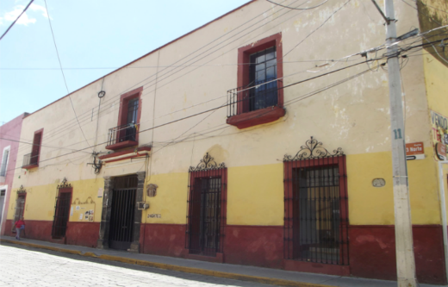
Atlixco, Puebla, as a case study
It is legally recognised as a Zone of Historical Monuments. Furthermore, it is close to the epicentre (ca. 40km).
The set of nine buildings (sample) are:
  Catalogued as a Historical Monuments;
  Masonry constructions of no more than three levels;
  Commercial and/or housing typologies;
  Clearly visible in Google Maps before and after the earthquake.
Seismic intensity (I): 7.5*
Structural ductility (Q): 1.0**
*USGS map of intensities https://earthquake.usgs.gov/earthquakes/eventpage/us2000ar20/
map?historic-seismicity=true&shakemap-intensity=false
**Table 4.2.3 of the Complementary Technical Code for Seismic Design of the Building Code for Mexico City
Photographs taken from the corresponding datasheets of the Nacional Catalogue for Historical Monuments.
Instituto Nacional de Antropología e Historia México. Coordinación Nacional de Monumentos Históricos (2020) Datasheets number I-21-00121, I-21-00078, I-21-00107, I-21-00083, I-21-00087, I-21-00086, I-21-00024, I-21-00066 and I-21-00079. In: Catálogo Nac. Monum. Históricos Inmuebles. https://www.catalogonacionalmhi.inah.gob.mx/consultaPublica. Accessed 26 Jan 2021

Slide 9
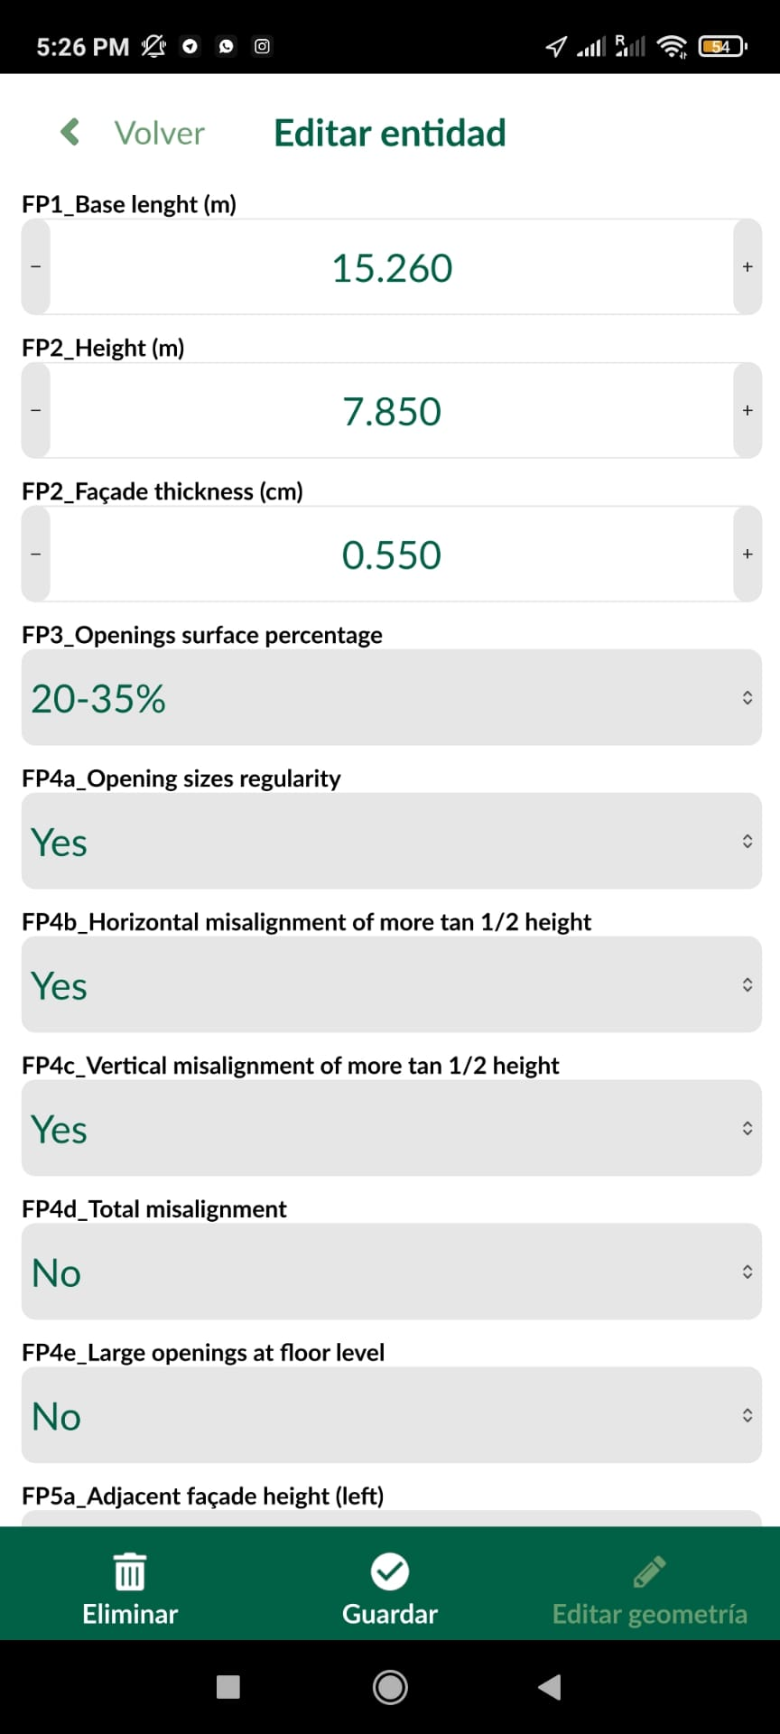
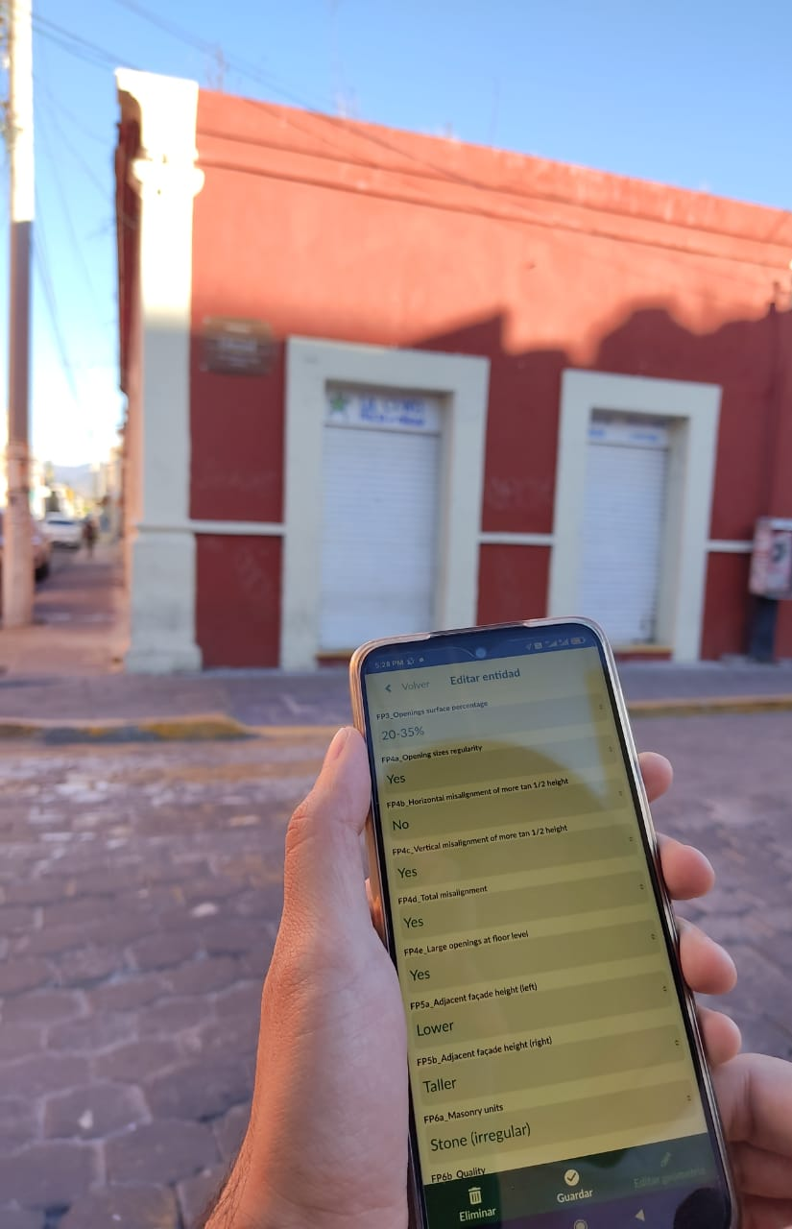
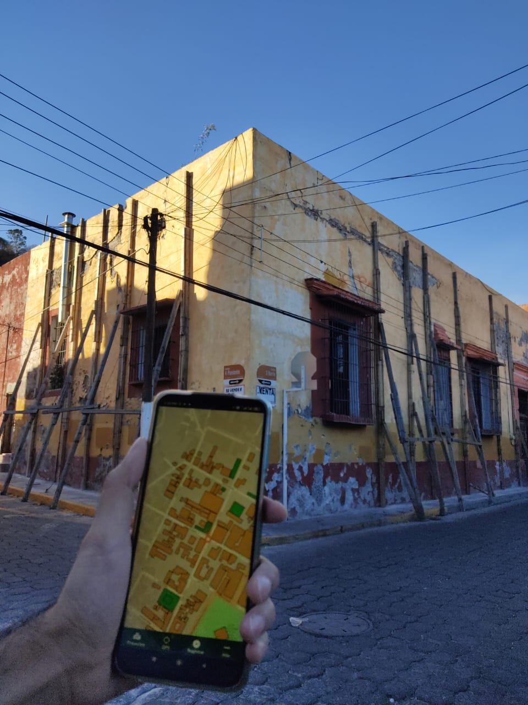
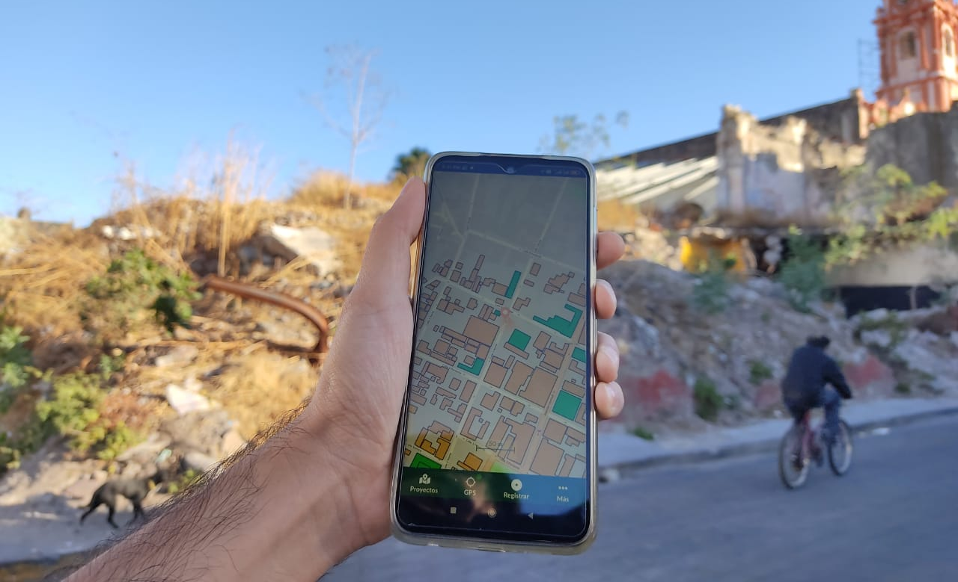
Atlixco, Puebla, as a case study
The constructions were mapped in a QGIS database. The multiple attributes that permit to grade the parameters were programmed as an Attribute Table.
The file was stored in the cloud service Mergin. That cloud permits to synchronise the file for multiple users and platforms.
The database was accessed from a mobile phone in which the app Input was installed. Then, it becomes possible to edit the file on site. Furthermore, the file was able to be synchronised in real-time, continuously saving the data.
Data acquisition process

Slide 10
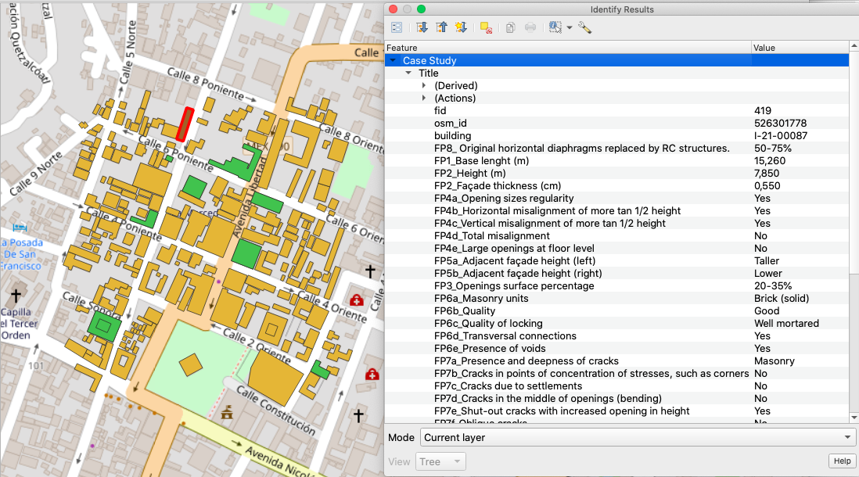
Atlixco, Puebla, as a case study
Data was available and downloadable from the QGIS interface.
The use of logic and arithmetic operators permitted to calculate the vulnerability index for constructions, as well as the mean damage grade and the expected discrete damage grades.
The observed damage grade d_{k} was supported by visual and photographic evidence.
Screenshots of the QGIS interface during the data retrieval.

Slide 11
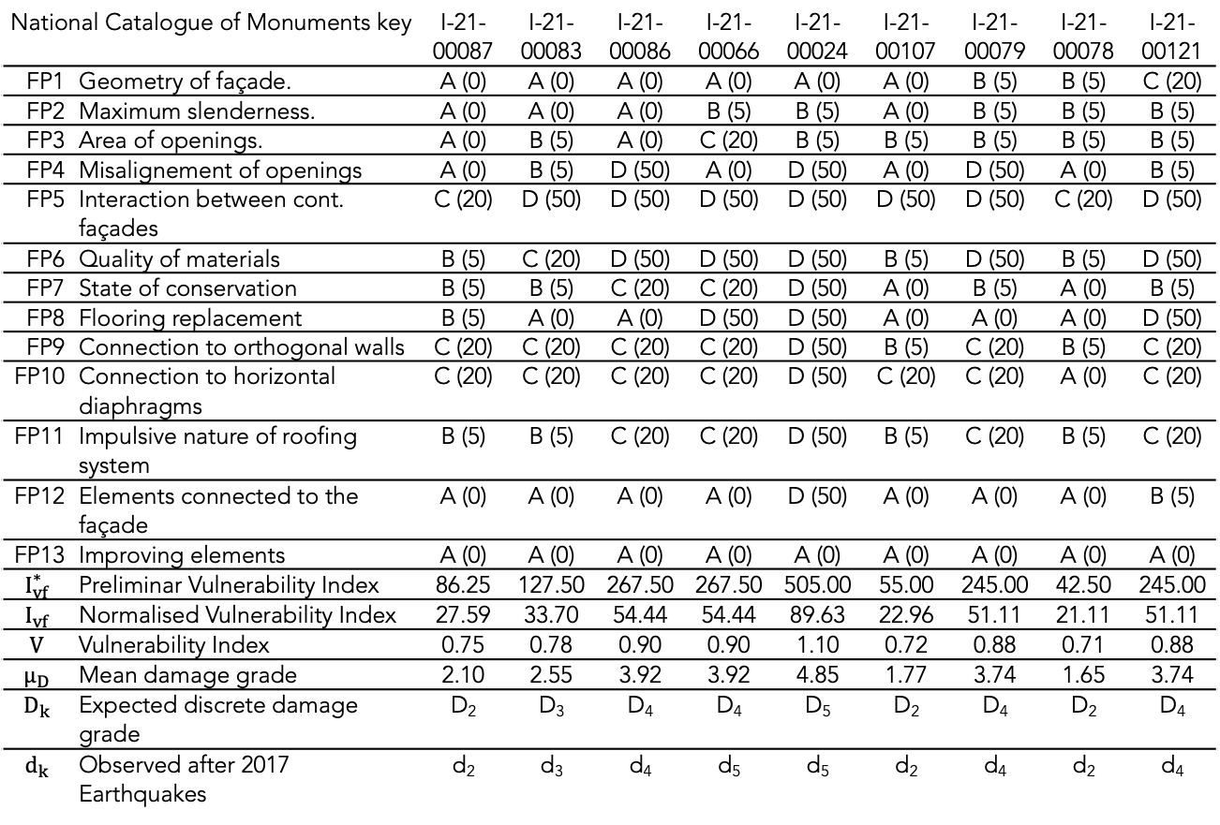
Results
National Catalogue of Monuments key |  | I-21-00087 | I-21-00083 | I-21-00086 | I-21-00066 | I-21-00024 | I-21-00107 | I-21-00079 | I-21-00078 | I-21-00121
FP1 | Geometry of façade. | A (0) | A (0) | A (0) | A (0) | A (0) | A (0) | B (5) | B (5) | C (20)
FP2 | Maximum slenderness. | A (0) | A (0) | A (0) | B (5) | B (5) | A (0) | B (5) | B (5) | B (5)
FP3 | Area of openings. | A (0) | B (5) | A (0) | C (20) | B (5) | B (5) | B (5) | B (5) | B (5)
FP4 | Misalignement of openings | A (0) | B (5) | D (50) | A (0) | D (50) | A (0) | D (50) | A (0) | B (5)
FP5 | Interaction between cont. façades | C (20) | D (50) | D (50) | D (50) | D (50) | D (50) | D (50) | C (20) | D (50)
FP6 | Quality of materials | B (5) | C (20) | D (50) | D (50) | D (50) | B (5) | D (50) | B (5) | D (50)
FP7 | State of conservation | B (5) | B (5) | C (20) | C (20) | D (50) | A (0) | B (5) | A (0) | B (5)
FP8 | Flooring replacement | B (5) | A (0) | A (0) | D (50) | D (50) | A (0) | A (0) | A (0) | D (50)
FP9 | Connection to orthogonal walls | C (20) | C (20) | C (20) | C (20) | D (50) | B (5) | C (20) | B (5) | C (20)
FP10 | Connection to horizontal diaphragms | C (20) | C (20) | C (20) | C (20) | D (50) | C (20) | C (20) | A (0) | C (20)
FP11 | Impulsive nature of roofing system | B (5) | B (5) | C (20) | C (20) | D (50) | B (5) | C (20) | B (5) | C (20)
FP12 | Elements connected to the façade | A (0) | A (0) | A (0) | A (0) | D (50) | A (0) | A (0) | A (0) | B (5)
FP13 | Improving elements | A (0) | A (0) | A (0) | A (0) | A (0) | A (0) | A (0) | A (0) | A (0)
$$I_{vf}^{∗}$$ | Preliminar Vulnerability Index | 86.25 | 127.50 | 267.50 | 267.50 | 505.00 | 55.00 | 245.00 | 42.50 | 245.00
$$I_{vf}$$ | Normalised Vulnerability Index | 27.59 | 33.70 | 54.44 | 54.44 | 89.63 | 22.96 | 51.11 | 21.11 | 51.11
$$V$$ | Vulnerability Index | 0.75 | 0.78 | 0.90 | 0.90 | 1.10 | 0.72 | 0.88 | 0.71 | 0.88
$$µ_{D}$$ | Mean damage grade | 2.10 | 2.55 | 3.92 | 3.92 | 4.85 | 1.77 | 3.74 | 1.65 | 3.74
$$D_{k}$$ | Expected discrete damage grade | D₂ | D₃ | D₄ | D₄ | D₅ | D₂ | D₄ | D₂ | D₄
$$d_{k}$$ | Observed after 2017 Earthquakes | d₂ | d₃ | d₄ | d₅ | d₅ | d₂ | d₄ | d₂ | d₄
The workflow permitted to capture and store the data efficiently. All the samples were surveyed during the half of a journey.
There is a good fitting between the estimated and the observed damage grades, which supports the suitability of the approach.
However, the database, can be updated as many times as necessary, permitting to reassess the constructions after a determined intervention easily.

Slide 12
Conclusions
The use of open-source tools (QGIS, Mergin and Input) allowed to implement a robust, fast and reliable workflow for data acquisition and treatment.
It represents a suitable strategy for applying the Vulnerability Index Method on existing masonry constructions.
The possibility of distributing and synchronising the database on multiple devices may facilitate the use of brigades or teams for covering large samples.
The results obtained from the application of the approach in the city of Atlixco, Puebla, seem to prove the suitability of the method for assessing the seismic vulnerability of traditional Mexican masonry buildings. If that can be confirmed with further data, this approach would be a valuable tool for supporting urban planning and seismic risk mitigation decision making.

Slide 13
Obrigado
Gracias
Thank you
This work was partly financed by FCT / MCTES through national funds (PIDDAC) under the R&D Unit Institute for Sustainability and Innovation in Structural Engineering (ISISE), under reference UIDB / 04029/2020
This work is financed by national funds through FCT - Foundation for Science and Technology, under grant agreement PD/BD/150385/2019 attributed to the 1st author.

