Slide 1
2nd Croatian Conference on Earthquake Engineering 2CroCEE 2023
Physical and virtual experimental investigation of self-centring concentrically braced frames
(Towards implementation of codified design methodology for
self-centring concentrically braced frames)
Borjan Petreski, Igor Gjorgjiev
Ss. Cyril and Methodius University in Skopje, Institute of Earthquake Engineering and Engineering Seismology

Slide 2
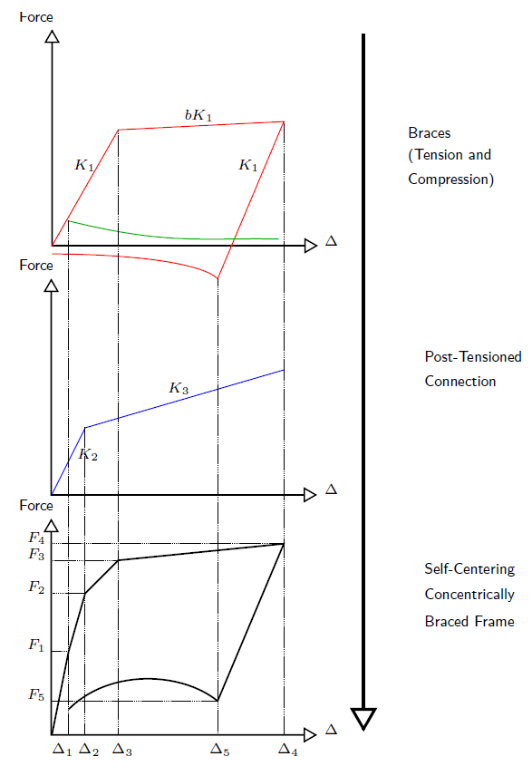
O’Reilly, G., Goggins, J. (2021)
System Definition
Schematic of the combined response of the individual components of the system
2nd Croatian Conference on Earthquake Engineering, Zagreb, Croatia, 22-24 March 2023

Slide 3
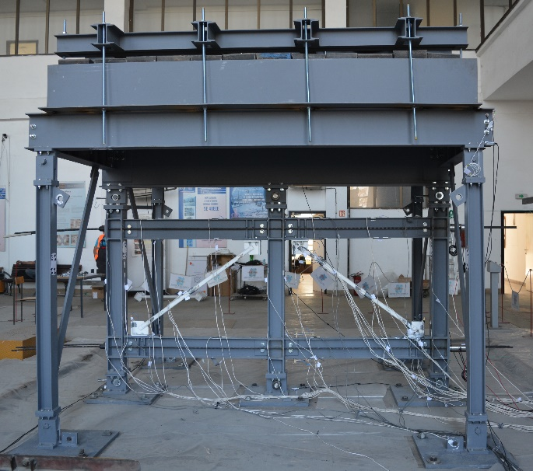
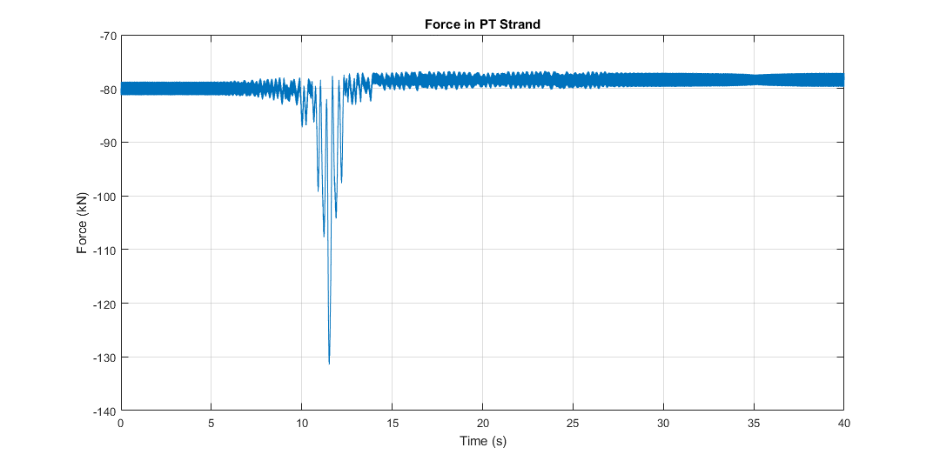
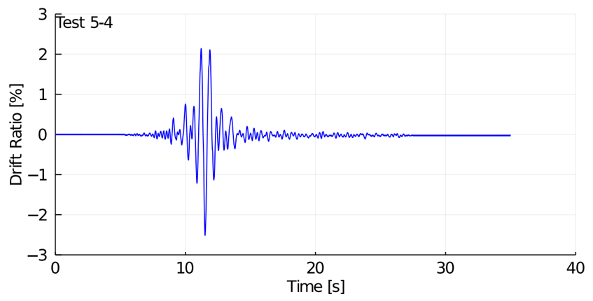
Experimental Testing
Validation of theoretical system behaviour
2nd Croatian Conference on Earthquake Engineering, Zagreb, Croatia, 22-24 March 2023

Slide 4
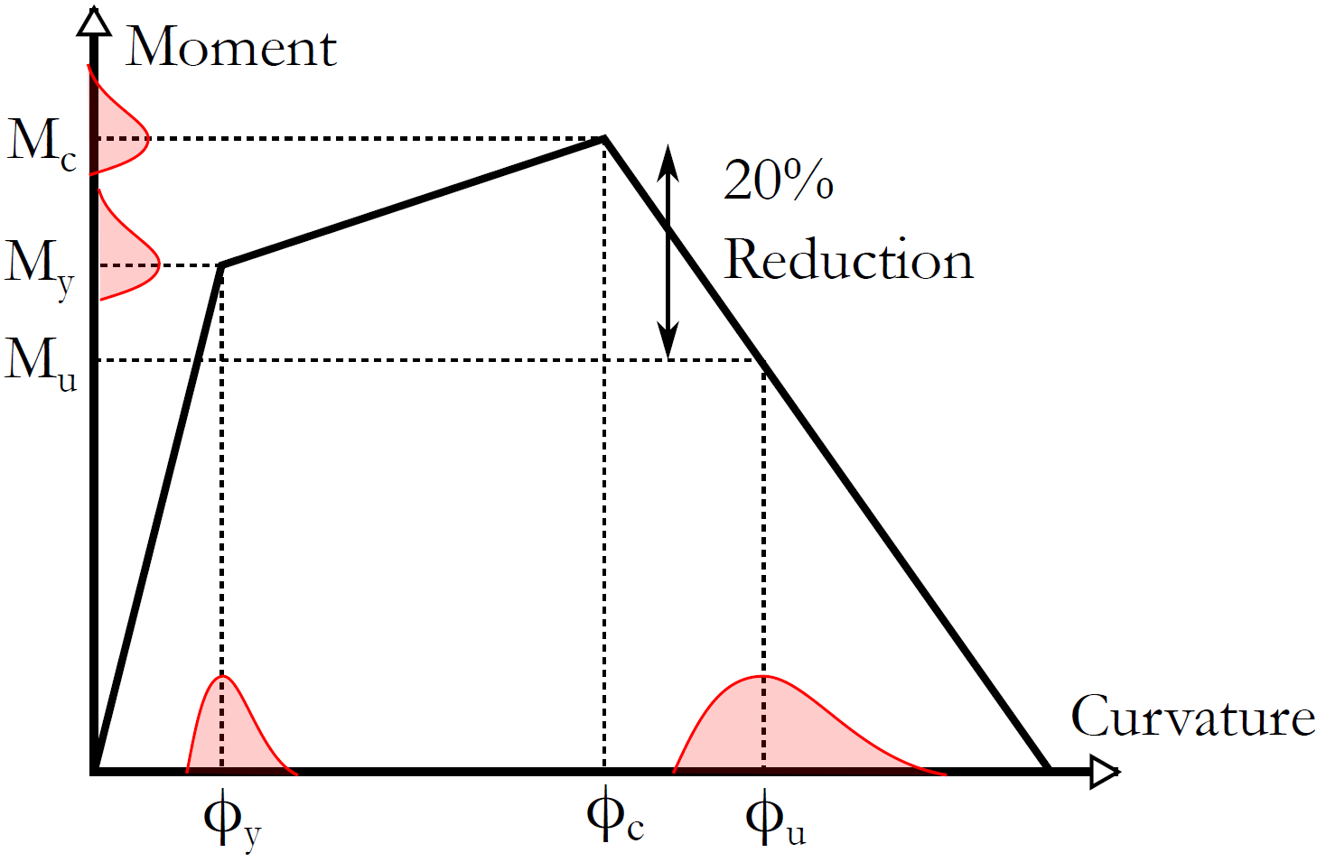
Baltzopoulos et al. (2017)
Virtual Testing
Model error estimation
2nd Croatian Conference on Earthquake Engineering, Zagreb, Croatia, 22-24 March 2023

Slide 5
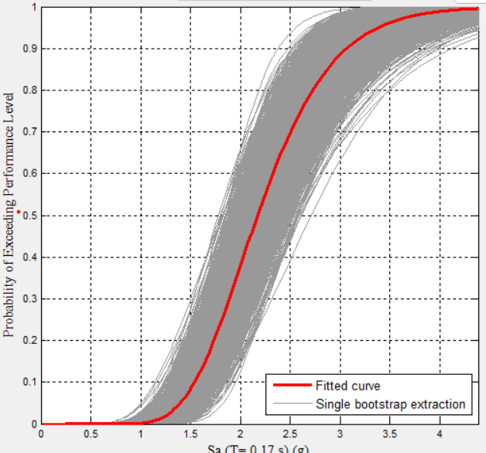
FF Development
Seismic fragility assessment
2nd Croatian Conference on Earthquake Engineering, Zagreb, Croatia, 22-24 March 2023

Slide 6
Site hazard assessment and ground motion selection
Selection and design of archetype buildings
Acceptance or rejection of q-factor
Nonlinear modelling
Static analysis
Dynamic analysis
Performance criteria and fragility assessment
Vamvatsikos et al. (2020)
EC8 Conforming Design
INNOSEIS approach for codified design methodology of SC-CBF
2nd Croatian Conference on Earthquake Engineering, Zagreb, Croatia, 22-24 March 2023

Slide 7
Site hazard assessment and ground motion selection
Selection and design of archetype buildings
Acceptance or rejection of q-factor
Nonlinear modelling
Static analysis
Dynamic analysis
Performance criteria and fragility assessment
Baltzopoulos et al. (2017)
O’Reilly, G., Goggins, J. (2021)
Vamvatsikos et al. (2020)
System Definition
Experimental Testing
Virtual Testing
FF Development
Seismic fragility assessment
EC8 Conforming Design
Schematic of the combined response of the individual components of the system
Validation of theoretical system behaviour
Model error estimation
INNOSEIS approach for codified design methodology of SC-CBF
2nd Croatian Conference on Earthquake Engineering, Zagreb, Croatia, 22-24 March 2023

